Slide 1
University-School Collaboration through Action Research
Kazuyoshi Sato, PhD
Nagoya University of Foreign Studies
AILA 2014

Slide 2
Introduction
Although Gordon (2008) affirms that “schoolwide collaborative action research is the most powerful type of collaborative research because of its potential for bringing about whole-school improvement” (p. 1-2, italics in original), little is known about how teachers have actually incorporated action research into their practice and worked with other teachers for curriculum development.

Slide 3
Definition of AR
“Action research is simply a form of self-reflective enquiry undertaken by participants in order to improve the rationality and justice of their own practices, their understanding of these practices and the situations in which the practices are carried out.” (Carr & Kemmis, 1986, p. 162)

Slide 4
A Spiral Process
Plan
(2) Act
(3) Observe
(4) Reflect
(Kemmis & McTaggart, 1988)

Slide 5
Shift Toward Critical and Collaborative AR
Burns (2005) argues for the shift from individualistic approach to critical/collaborative one to describe “how AR can be integrated into ongoing collaborative teacher development processes that can create the conditions to support and influence institutional change” (Burns, 2005, p. 247)

Slide 6
Research Issue
“Published studies of AR in ELT are still relatively small in number” and few were reported “by teachers of AR conducted for their own professional development within a larger collaborative grouping” (Burns, 2005, p. 248)

Slide 7
Mutoh, Sato, Hakamada, Tsuji and Shintani (2009)
・15 school teachers (one elementary, seven junior high, and seven senior high school teachers) worked on collaborative AR.
・met once a month, reported on their practices, and received comments from two university teachers and other participants.
・12 teachers said that they had improved their practices through the continuous action research cycle of implementation, reflection, and revision.
・only four teachers shared new ideas they had learned from action research with other teachers in their schools and only one teacher actually utilized action research for curriculum development at his school.

Slide 8
Research Questions
(1)How do teachers communicate and collaborate for the curriculum reform project?
(2)How do students change their attitudes toward learning English and improve their ability through the curriculum reform project?
(3)What are the difficulties in implementing the schoolwide curriculum reform project?

Slide 9
Context
Kagamihara Senior High School, a public school with three courses including general, math and science, and English courses.
at a lower intermediate level
top-down curriculum reform project started in 2008
became a prefectural project from 2009 to 2011

Slide 10
Goals of the English Curriculum
 | Listening | Speaking | Reading | Writing
1st year | Understand 70% of what the teacher and the CD say | Manage a three-minute conversation | Understand the text with 150 words | Complete an essay with 100 words
2nd year | Understand 80% of what the teacher and the CD say | Manage a four-minute conversation | Understand the text with 300 words | Complete an essay with 150 words
3rd year | Understand 90% of what the teacher and the CD say | Manage a five-minute conversation | Understand the text with 400 words | Complete an essay with 200 words

Slide 11
Participants
2008 | 2009 | 2010 | 2010
4 first-year teachers (1 ALT) | 8 first-year and second-year teachers (1 ALT) | All 12 teachers (1 ALT) | All 12 teachers (1 ALT)

Slide 12
Mixed Methods
Qualitative data: Hirano’s story
Quantitative data: student surveys for three years and the ACE (Assessment of Communicative English) test conducted in 2011

Slide 13
Qualitative Results
Year One
At the beginning of April, it took some time for students to become accustomed to all the classes being taught only in English. However, my colleagues soon told me that almost no students slept during the class and there was an increase in motivation for studying English. Teachers had a meeting once a week for sharing problems related to our lessons. We also talked about the rubrics of both a speaking test and a writing test. I was surprised and happy to see the improvement in students’ speaking ability in their first speaking test in front of a video camera. Even though the students were nervous, most somehow managed a three-minute conversation about a familiar topic using basic conversation strategies. Moreover, I was pleased to see students’ writing, which we call “fun essays” because they use colorful paper and include club photos.

Slide 14
Qualitative Results
Year One
・I did not want to write something in English because my English was poor. But I could gradually get used to writing. Finally I completed a fun essay. I was a little embarrassed that not only my classmates but also students from different classes looked at mine and some friends told me my work was cute and colorful. I was very happy. (Student A)
・I was surprised to see the rubric for the fun essay as I was not good at English. But as one of the criteria was design, I wrote my essay without worrying about my English. I want to increase the number of the words for the next fun essay. (Student B)

Slide 15


Slide 16
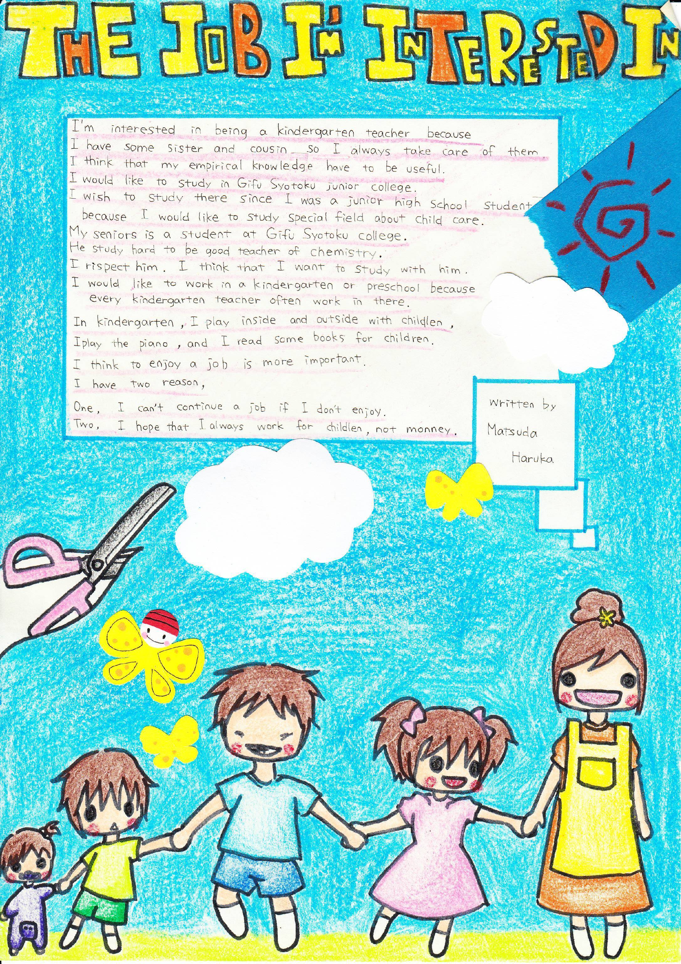

Slide 17
Qualitative Results
Year One
My colleagues were also moved when they saw their students’ work displayed in the hallway. They told me that they had not expected their students to complete such excellent essays. In addition, it was a good opportunity for teachers of other subjects to see what we had been doing for the English curriculum reform project. Two English teachers gave me the following comments:

Slide 18
Qualitative Results
Year One
The essays of the first-year students were much better than those of the second-year students as theirs were much more colorful and longer. (Teacher A)
I did not know that some students of my homeroom class were good at design. It was a good thing to show us students’ essays because we could not easily see what the reform project was. (Teacher B)

Slide 19
Qualitative Results
Year Two
All the second-year students started one-hour extensive reading once a week from the second semester following the advice of Sato and continued reading the True Stories series in addition to the textbook. They were able to read the content of the stories more quickly than before. All the teachers involved in extensive reading told me that their students suddenly concentrated on reading the books of the Oxford Reading Tree (ORT) and Foundations Reading Library (FRL) series. I realized that those books had an impact on students’ motivation.

Slide 20




True Stories Series
Foundation Reading Library
Oxford Reading Tree

Slide 21
Qualitative Results
Year Two
As I disliked studying English, I did not understand why we should move to another room just to read. But I was shocked when I read through the books of the ORT series. It was easy for me to read those books with a small number of words and various pictures. (Student D)
I didn’t expect that the contents of the stories of ORT and FRL would be enjoyable. I had never had the experience of being devoted to reading something written in English. (Student E)
I naturally memorized the characteristics of the characters in the stories so I enjoyed talking with my friends about them. At the same time, friends gave me comments about stories I hadn’t read yet or I was going to read. (Student F)

Slide 22
Qualitative Results
Year Three
For the final speaking test in December, almost all the students were able to manage a five-minute conversation about a social topic using all the conversation strategies they had learned. Teachers noted that they strove to succeed in the final speaking test especially by using follow-up questions. As both teachers and students worked hard toward the same goal, the students performed noticeably better on the speaking test. It was vital to implement a speaking test to improve students’ speaking skills.

Slide 23
Qualitative Results
Year Three
Thanks to small talk (warm-up conversations) at the start of every class, I am sure that my speaking skills improved. We had an opportunity to use what we learned in small talk for the speaking test, and it was especially useful for me to pass the 2nd-grade Eiken interview test. (Student G)
Even though rotating my position to talk with different partners annoyed me, I actually stole some useful expressions from my partners during small talk. (Student H)
I learned that I needed a lot of background knowledge in order to be able to keep talking about not only familiar topics but also social topics. (Student I)

Slide 24
Summary of Qualitative Results
Through participating in this lesson reform project, I have learned a number of things. I had a fulfilling time teaching English through integrated skills learning. I was astonished to see our students improve their English skills.
However, I had great difficulty in developing a three-year communicative curriculum. I would like to highlight two of these problems.

Slide 25
Summary of Qualitative Results
1. The first difficulty was making handouts for each lesson based on skill integration and the framework suggested by Lee and VanPatten (2003). The handouts included an information-exchange task as the lesson goal and students worked toward the speaking test and fun essay. I spent hours making handouts and modifying them following Sato’s advice and my colleagues’ feedback.

Slide 26
Summary of Qualitative Results
2. The second difficulty was teacher collaboration. Some teachers with strong beliefs in traditional methods of language teaching and learning regularly complained about communicative teaching in English teachers’ meetings. However, I fortunately had the great privilege of collaborating with two other teachers for three years. We had not only a weekly one-hour meeting but also other informal meetings to share problems and feedback. My colleagues and I discussed how to implement each activity on the handouts, the speaking tests, fun essays, extensive reading, and surveys. Those meeting were essential to improving our lessons. We also received substantial advice from Sato for the project after his observations of our English classes every other week.

Slide 27
Quantitative Results
Table 3. Speaking Skills of First-Year Students in February 2009 (Familiar Topics)
A three-minute timed conversation | Can completely manage using shadowing and rejoinders | Can almost manage using shadowing and rejoinders | Can somehow manage using shadowing and rejoinders | Can hardly manage | Cannot manage at all
275 students | 25% | 42% | 27% | 5% | 1%

Slide 28
Quantitative Results
Table 4. Speaking Skills of Second-Year Students in February 2010 (Familiar Topics)
A five-minute timed conversation | Can completely manage using shadowing, rejoinders, and follow-up questions | Can almost manage using shadowing, rejoinders, and follow-up questions | Can somehow manage using shadowing, rejoinders, and follow-up questions | Can hardly manage | Cannot manage at all
273 students | 23% | 64% | 9% | 4% | 0%

Slide 29
Quantitative Results
Table 5. Speaking Skills of third-Year Students in February 2011 (Social Topics)
A five-minute timed conversation | Can completely manage using shadowing, rejoinders, and follow-up questions | Can almost manage using shadowing, rejoinders, and follow-up questions | Can somehow manage using shadowing, rejoinders, and follow-up questions | Can hardly manage | Cannot manage at all
261 students | 5% | 63% | 27% | 5% | 0%

Slide 30
Quantitative Results
Table 6. Writing Skills of First-Year Students in February 2009 (Familiar Topics)
A fun essay | Can write over 150 words | Can write over 120 words | Can write over 100 words | Can write over 80 words | Can write with fewer than 80 words
274 students | 13% | 48% | 24% | 14% | 1%

Slide 31
Quantitative Results
Table 7. Writing skills of Second-Year Students in February 2010 (Familiar Topics)
A fun essay | Can write over 150 words | Can write over 120 words | Can write over 100 words | Can write over 80 words | Can write fewer than 80 words
273 students | 53% | 33% | 11% | 2% | 1%

Slide 32
Quantitative Results
Table 8. Writing Skills of Third-Year Students in February 2011 (Social Topics)
A fun essay | Can write over 200 words | Can write over 150 words | Can write over 120 words | Can write over 100 words | Can write fewer than 100 words
271 students | 13% | 49% | 37% | 1% | 0%

Slide 33
Quantitative Results
Table 9. The Results of ACE Tests in 2011 School Year
 | 430~449 (Standard score for first-year students) | 450~469 (Standard score for second-year students) | 470 ~499 (Standard score for third-year students) | 500 ~ 599 | 600 ~ 699 | 700
First-year (April) | 18 (6.5%) | 6 (5.7%) | 4 (1.4%) | 6 (2.2%) | 0 | 0
First-year (January) | 36 (12.9%) | 26 (9.3%) | 10 (3.5%) | 7 (2.5%) | 3 (1.1%) | 0
Second-year (April) | 45 (15.1%) | 17 (5.7%) | 7 (2.3%) | 1 (0.3%) | 0 | 0
Second-year (Jan) | 38 (12.8%) | 41 (13.8%) | 30 (10.1%) | 8 (2.7%) | 1 (0.3%) | 0
Third-year (April) | 42 (15.7%) | 36 (13.4%) | 26 (9.7%) | 18 (6.7%) | 3 (1.1%) | 0
Third-year (Jan) | 37 (13.8) | 34 (12.7%) | 34 (12.7%) | 31 (11.6%) | 4 (1.5%) | 2 (0.7%)

Slide 34
Discussion
How did teachers communicate and collaborate for the curriculum reform project?
As Hirano revealed, he and his colleagues had informal gatherings in addition to weekly meetings so as to discuss how to use handouts and solve problems. The results attest to the finding that teacher collaboration leads to better student learning (McLaughlin & Talbert, 2001; Sato & Takahashi, 2008). Unfortunately, Hirano reported that there were other teachers who were unwilling to collaborate due to different beliefs about language learning and teaching. Hawley and Valli (1999) claim that “Without collaborative problem solving, individual change may be possible, but school change is not” (p. 141).

Slide 35
Discussion
2. How did students change their attitudes toward learning English and improve their ability through the curriculum reform project?
The results indicate that students improved their English ability in terms of both fluency and accuracy. One of the important things we learned from this project was integrating teaching and assessment. Brown (2007) affirms that assessment and teaching should be partners for successful language learning. Because the final grade included speaking tests (20%) and fun essays (20%), both teachers and students worked hard on performance tests.

Slide 36
Discussion
3. What were the difficulties in implementing the schoolwide curriculum reform project?
Hirano revealed two difficulties in his narrative. One was developing handouts based on skill integration and the other was teacher collaboration. Regarding the first, Hirano spent hours developing handouts and modified them based on the advisor’s comments and feedback from his colleagues. This study indicates that teachers can put theory into practice successfully and make a difference in student learning if they receive continuous teacher learning opportunities and advice from a mentor (see Mutoh, Sato, Hakamada, Tsuji, & Shintani, 2009).

Slide 37
Discussion
Yet, an unresolved issue remains. As Hirano reported, there were teachers who were unwilling to participate in the curriculum reform project, which had been mandated by the prefectural Board of Education. Because it was a top-down reform project, Sato observed that some teachers did not collaborate and did not follow the handouts that grade-level leaders made over the four years. As the literature on teacher beliefs and practices indicates, beliefs are difficult to change, tend to self-perpetuate, and affect practices (Pajares, 1992). Moreover, school culture is influential in forming individual teachers’ beliefs (Sato, 2002; Sato & Kleinsasser, 2004). How can teachers collaborate with others and develop a collaborative school culture? How do teachers change their beliefs and practices in a collaborative school culture?

Slide 38
Conclusion
Collaborative AR empowers teachers to be continuous learners and AR “has a potential to be a powerful agent of educational change” (Milles, 2003, p. v). However, to make it happen, these teachers need support both from their colleagues and policy makers to make their schools collaborative learning communities (see Murphey & Sato, 2005, Sato & Kleinsasser, 2004; Sato & Takahashi, 2008)

Slide 39
References
Carr, W., & Kemmis, S. (1986). Becoming critical: Knowing through action research. London: Falmer.
Bransford, J.D., Brown, A.L.,& Cocking, R.R. (Eds.) (2000). How people learn. Washington, D.C.: National Academy Press.
Burns, A. (1999). Collaborative action research for English language teachers. Cambridge: Cambridge University Press.
Burns, A. (2005). Action research. In E. Hinkel (Ed.), Handbook of research in second language teaching and learning (pp. 241-256). London: Lawrence Erlbaum Associates.
Kemmis, S., & McTaggart, R. (Eds.). (1986). The action research planner. Geelong, VIC: Deakin University Press.

Slide 40
References
Lightbown, P. M., & Spada, N. (2006). How languages are learned (3rd edition). Oxford: Oxford University Press.
Milles, G. E. (2003). Action research: A guide for the teacher researcher (2nd edition). Upper Saddle River, NJ: Peason Education, Inc.
Murphey, T., & Sato, K. (Eds.). (2005). Communities of Supportive Professionals. Alexandria, VA: TESOL Inc.
Sato, K. (2003). Starting a local teacher study group. In T. Murphey (Ed.), Extending professional Contributions (pp. 97-104). Alexandria, VA: TESOL Inc.
Sato, K., & Kleinsasser, R. C (2004). Beliefs, practices, and interactions of teachers in Japanese high school English department. Teaching and Teacher Education, 20, 797-816.

Slide 41
References
Sato, K., & Takahashi, K. (2008). Curriculum revitalization in a Japanese high school through teacher collaboration. In D. Hayes & J. Sharkey (Eds.), Revitalizing a program for school-age learners through curricular innovation (pp. 205-237). Alexandria, VA: TESOL, Inc.
Zeichner, K.M., & Noffke, S.E. (2001). Practitioner research. In V. Richardson (Ed.), Handbook of research of teaching (Fourth edition)(pp. 298-330). Washington, D.C: American Educational Research Association.

