Slide 1
Implementing a TBLT Curriculum in a Japanese High School through Collaborative Action Research
Kazuyoshi Sato, PhD
Nagoya University of Foreign Studies
2015 TBLT Conference, Leuven

Slide 2
Introduction
Ellis (2003) claimed that “[i]t should be noted that the rationale for task-based syllabuses is largely theoretical in nature, there being little empirical evidence to demonstrate that they are superior to linguistic syllabuses” (p. 210). Although TBLT has gained prominence in language leaning and teaching, there has been little discussion about how to develop a TBLT syllabus or a curriculum.

Slide 3
Introduction
Although Gordon (2008) affirms that “schoolwide collaborative action research is the most powerful type of collaborative research because of its potential for bringing about whole-school improvement” (p. 1-2, italics in original), little is known about how teachers have actually incorporated action research into their practice and worked with other teachers for curriculum development.

Slide 4
Definition of AR
“Action research is simply a form of self-reflective enquiry undertaken by participants in order to improve the rationality and justice of their own practices, their understanding of these practices and the situations in which the practices are carried out.” (Carr & Kemmis, 1986, p. 162)

Slide 5
A Spiral Process
Plan
(2) Act
(3) Observe
(4) Reflect
(Kemmis & McTaggart, 1988)

Slide 6
Shift Toward Critical and Collaborative AR
Burns (2005) argues for the shift from individualistic approach to critical/collaborative one to describe “how AR can be integrated into ongoing collaborative teacher development processes that can create the conditions to support and influence institutional change” (Burns, 2005, p. 247)

Slide 7
Research Issue
“Published studies of AR in ELT are still relatively small in number” and few were reported “by teachers of AR conducted for their own professional development within a larger collaborative grouping” (Burns, 2005, p. 248)

Slide 8
Research Questions
(1)How do teachers communicate and collaborate for the TBLT curriculum reform project?
(2)How do students change their attitudes toward learning English and improve their ability through the TBLT curriculum reform project?
(3)What are the difficulties in implementing the schoolwide TBLT curriculum reform project?

Slide 9
Context
Kagamihara Senior High School, a public school with three courses including general, math and science, and English courses.
at a lower intermediate level
Teachers used to teach based on GTM.
Top-down curriculum reform project started in 2008
(5) became a prefectural project from 2009 to 2012

Slide 10
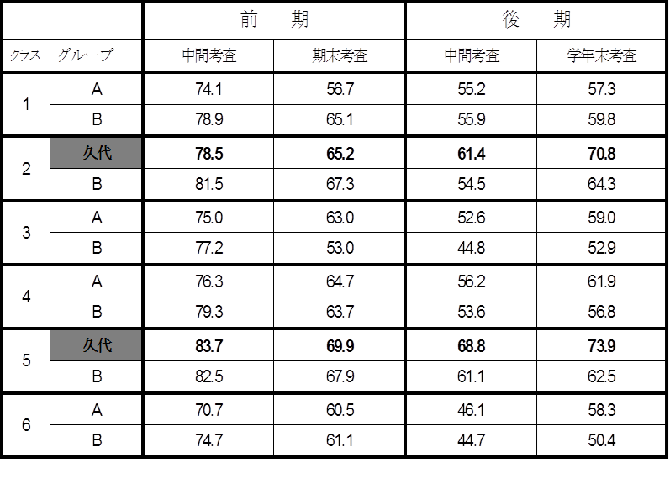

Slide 11
Participants
2008 | 2009 | 2010-2012
4 first-year teachers (1 ALT) | 8 first-year and second-year teachers (1 ALT) | All 12 teachers (1 ALT)

Slide 12
TBLT Curriculum
TBLT | 1st year→ | 2nd year→ | 3rd year→
1. Form-focused | Oral communication (planned, two 50-minute classes) | Writing (incidental, two 50-minute classes) | Writing (incidental, two 50-minute classes)
2. Form-unfocused | English I (Four 50-minute classes) | English II (Three 50-minute classes) | Reading (Three 50-minute classes)
 |  | Extensive reading (one 50-minute class) | Extensive reading (one 50-minute class)

Slide 13
Curriculum Reform Project
(after four years)
・A university professor was invited as an adviser and
TBLT was promoted for three years.
・Aiming at developing students’ communication skills in
English.
・All the English teachers in the same year shared
handouts and had a weekly meeting.
・Students became interested in learning English and
participated in class actively with the introduction of
performance tests.

Slide 14
Goals of the English Curriculum
 | Listening | Speaking | Reading | Writing
1st year | Understand 70% of what the teacher and the CD say | Manage a three-minute conversation in pairs | Understand the text with 150 words | Complete an essay with 100 words
2nd year | Understand 80% of what the teacher and the CD say | Manage a four-minute conversation in pairs | Understand the text with 300 words | Complete an essay with 150 words
3rd year | Understand 90% of what the teacher and the CD say | Manage a five-minute conversation in pairs | Understand the text with 400 words | Complete an essay with 200 words

Slide 15
Assessment
(1) Term Test 50%
(2) Speaking Test 20%
(3) Essay Writing (Fun Essay) 20%
(4) Portfolio (Self-evaluation) 10%

Slide 16
Mixed Methods
Qualitative data: Hirano’s story about form-unfocused classes for three years.
Quantitative data: student surveys for three years and the ACE (Assessment of Communicative English) test conducted in 2011
Qualitative data: 9 teacher interviews (after five years)

Slide 17
Flow of One Lesson
1. Small Talk
→ As a warm-up, a pair conversation using
about a general topic.
For example, “What did you do yesterday? “
conversation strategies
2. Set a Goal
3. Pre-reading
→ Activating the schema for understanding a topic
Skimming
4. While-reading
→ Understanding the content of the story using reading strategies such as scanning
Scanning
→ Implementing a speaking test and a fun essay for deeper understanding of the content and personalization
5. Post-reading

Slide 18
Qualitative Results
Year One
At the beginning of April, it took some time for students to become accustomed to all the classes being taught only in English. However, my colleagues soon told me that almost no students slept during the class and there was an increase in motivation for studying English. Teachers had a meeting once a week for sharing problems related to our lessons. We also talked about the rubrics of both a speaking test and a writing test. I was surprised and happy to see the improvement in students’ speaking ability in their first speaking test in front of a video camera. Even though the students were nervous, most somehow managed a three-minute conversation about a familiar topic using basic conversation strategies. Moreover, I was pleased to see students’ writing, which we call “fun essays” because they use colorful paper and include club photos.

Slide 19
Qualitative Results
Year One
・I did not want to write something in English because my English was poor. But I could gradually get used to writing. Finally I completed a fun essay. I was a little embarrassed that not only my classmates but also students from different classes looked at mine and some friends told me my work was cute and colorful. I was very happy. (Student A)
・I was surprised to see the rubric for the fun essay as I was not good at English. But as one of the criteria was design, I wrote my essay without worrying about my English. I want to increase the number of the words for the next fun essay. (Student B)

Slide 20
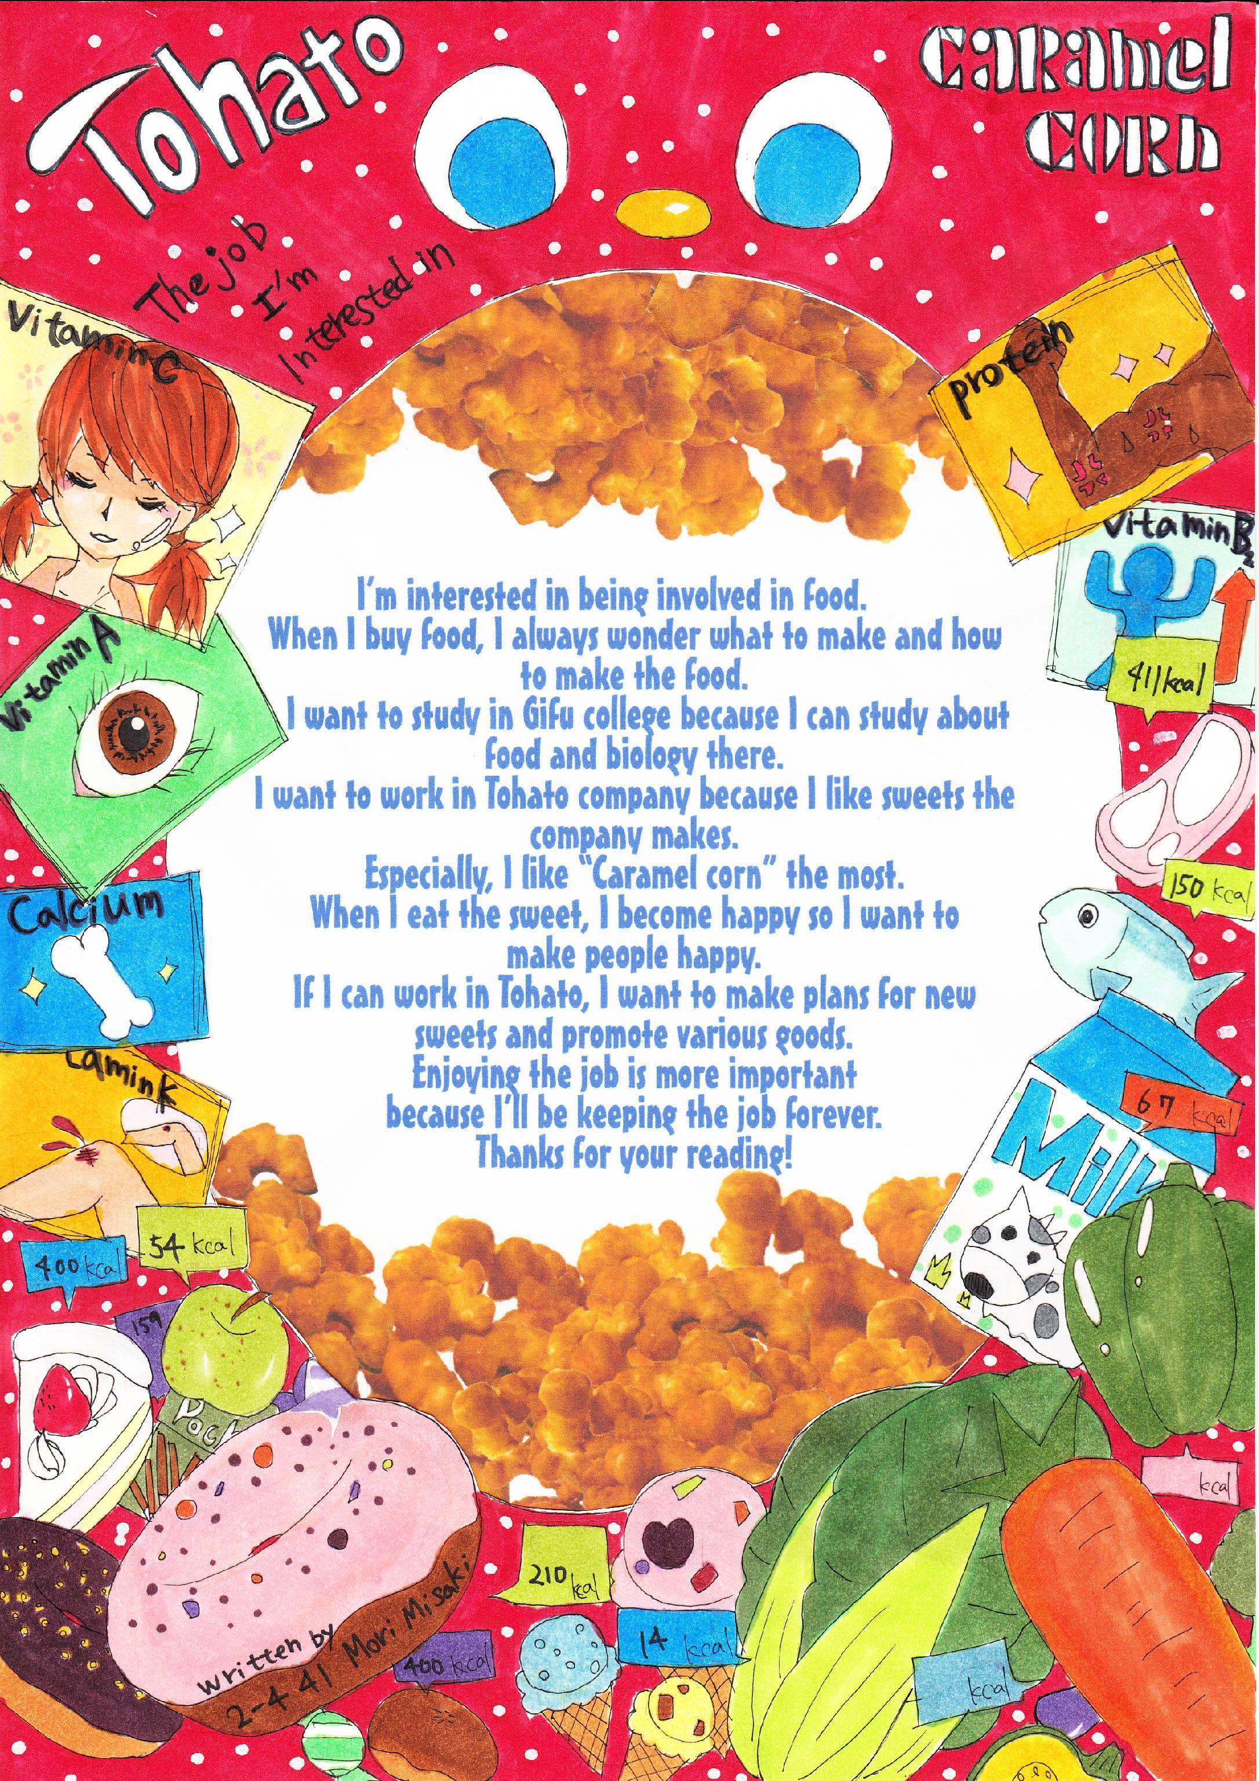

Slide 21
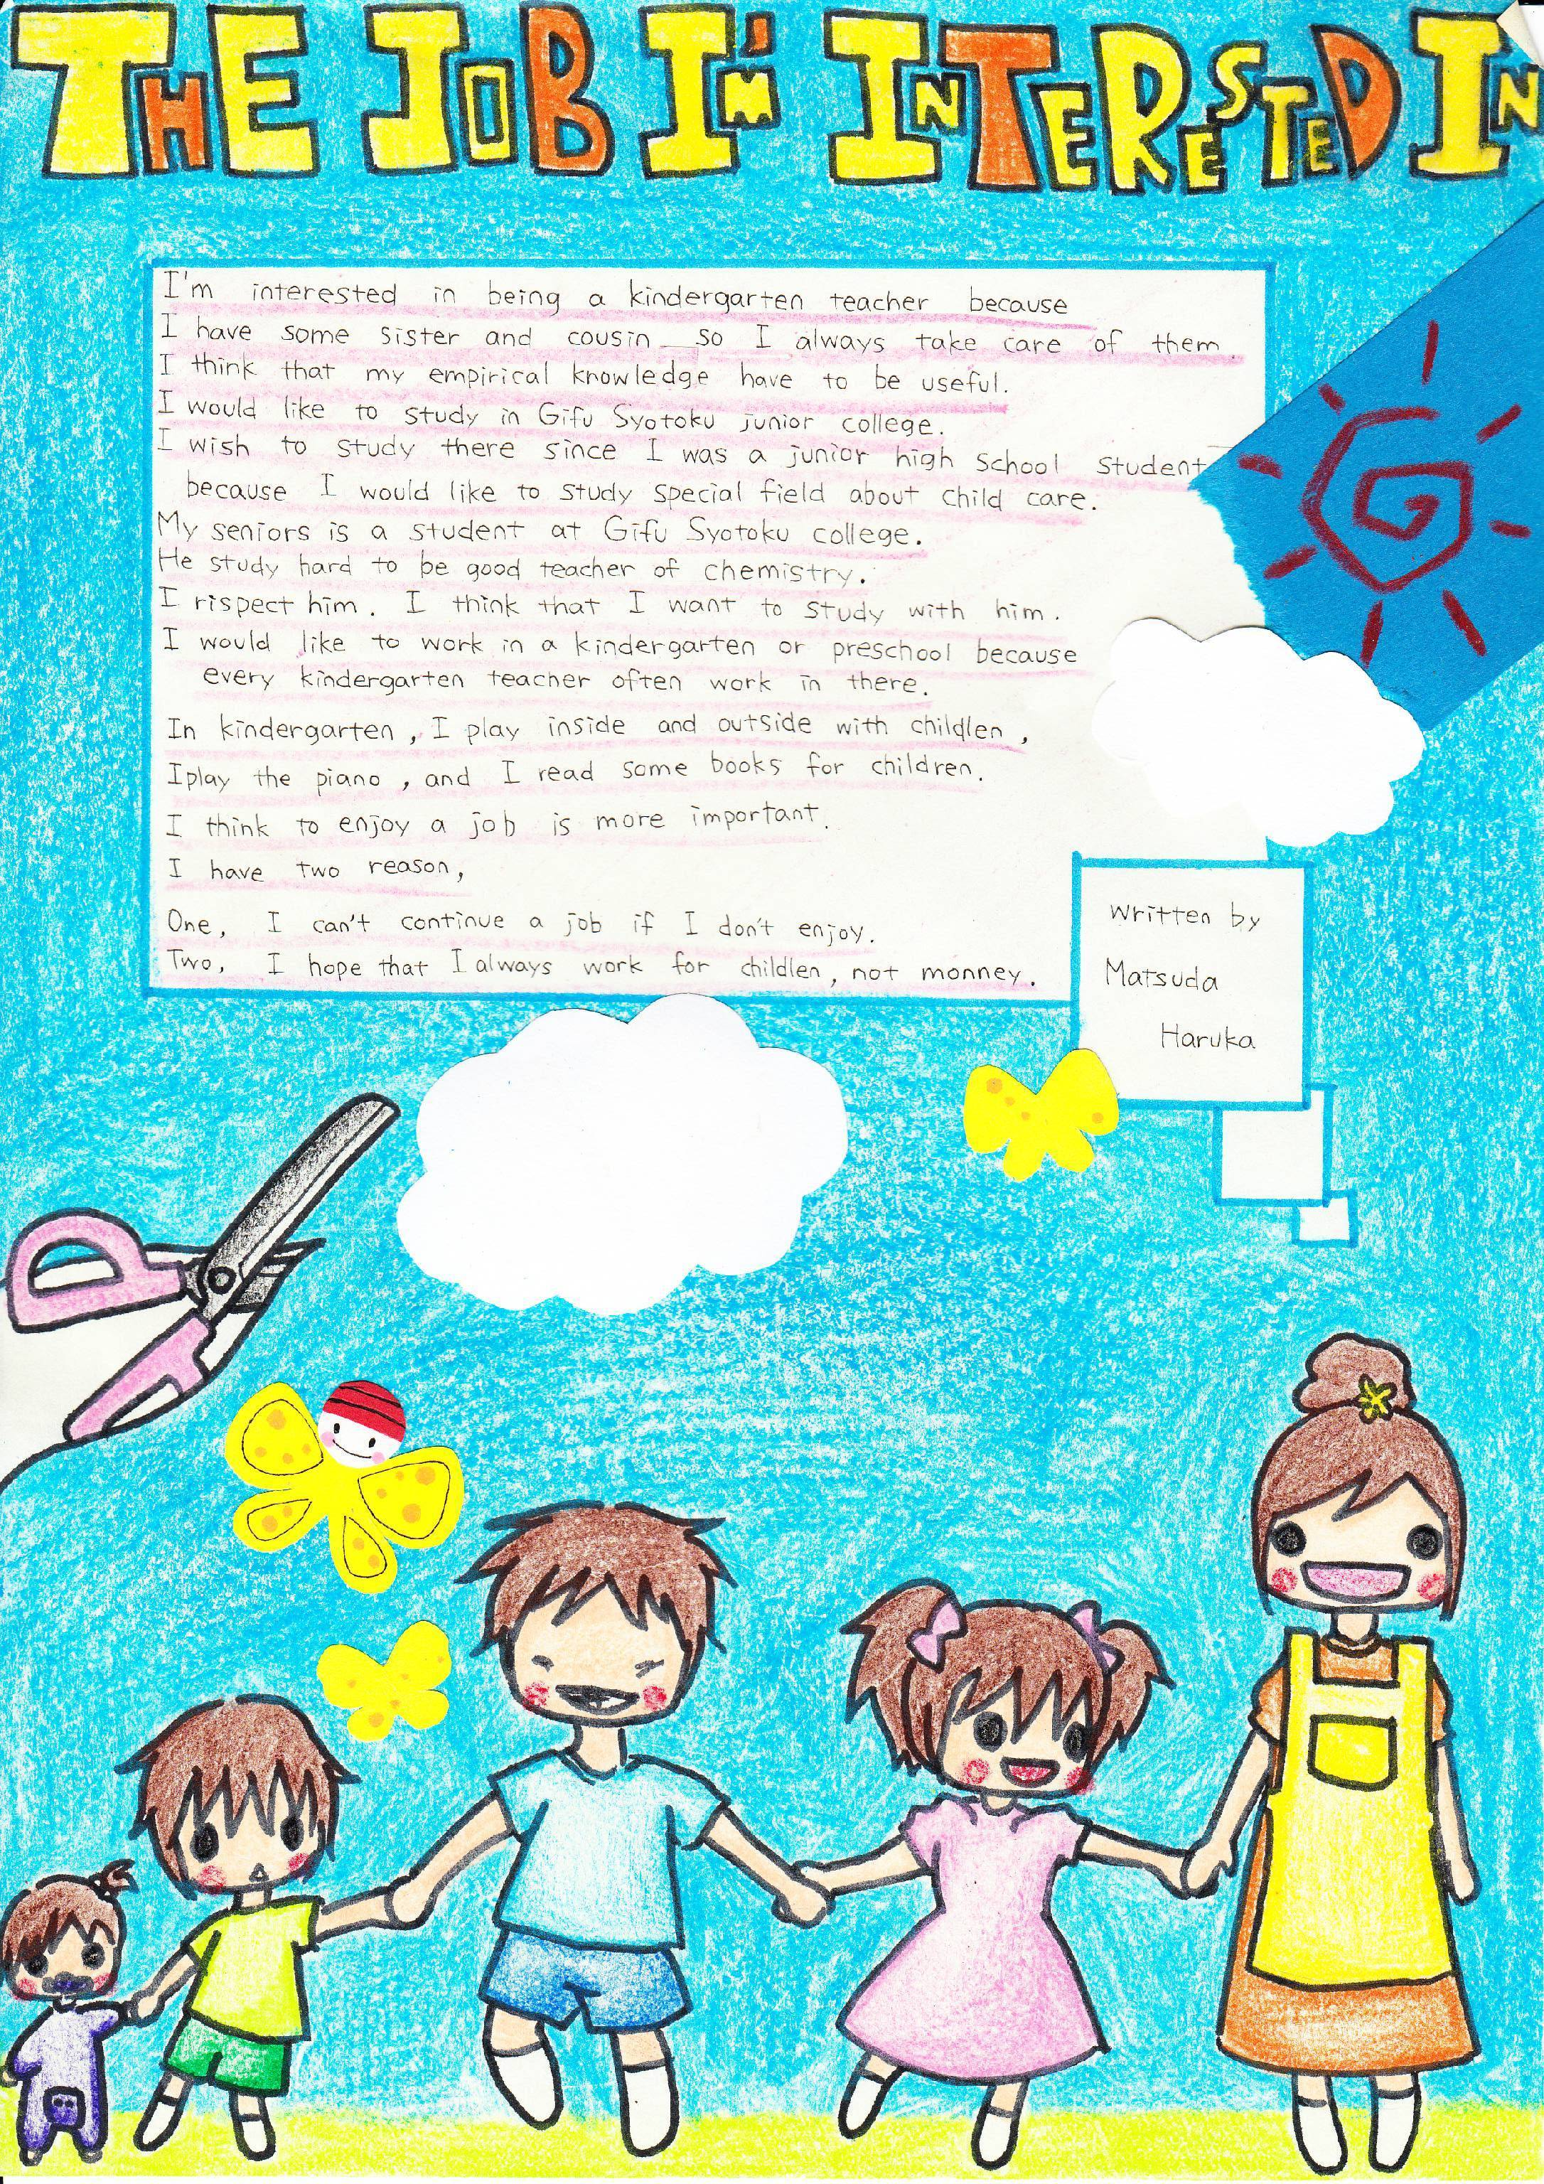

Slide 22
Qualitative Results
Year One
My colleagues were also moved when they saw their students’ work displayed in the hallway. They told me that they had not expected their students to complete such excellent essays. In addition, it was a good opportunity for teachers of other subjects to see what we had been doing for the English curriculum reform project. Two English teachers gave me the following comments:

Slide 23
Qualitative Results
Year One
The essays of the first-year students were much better than those of the second-year students as theirs were much more colorful and longer. (Teacher A)
I did not know that some students of my homeroom class were good at design. It was a good thing to show us students’ essays because we could not easily see what the reform project was. (Teacher B)

Slide 24
Qualitative Results
Year Two
All the second-year students started one-hour extensive reading once a week from the second semester following the advice by Sato and continued reading the True Stories series in addition to the textbook. They were able to read the content of the stories more quickly than before. All the teachers involved in extensive reading told me that their students suddenly concentrated on reading the books of the Oxford Reading Tree (ORT) and Foundations Reading Library (FRL) series. I realized that those books had an impact on students’ motivation.

Slide 25




True Stories Series
Foundation Reading Library
Oxford Reading Tree

Slide 26
Qualitative Results
Year Two
As I disliked studying English, I did not understand why we should move to another room just to read. But I was shocked when I read through the books of the ORT series. It was easy for me to read those books with a small number of words and various pictures. (Student D)
I didn’t expect that the contents of the stories of ORT and FRL would be enjoyable. I had never had the experience of being devoted to reading something written in English. (Student E)
I naturally memorized the characteristics of the characters in the stories so I enjoyed talking with my friends about them. At the same time, friends gave me comments about the stories I hadn’t read yet or I was going to read. (Student F)

Slide 27
Qualitative Results
Year Three
For the final speaking test in December, almost all the students were able to manage a five-minute conversation about a social topic using all the conversation strategies they had learned. Teachers noted that they strove to succeed in the final speaking test especially by using follow-up questions. As both teachers and students worked hard toward the same goal, the students performed noticeably better on the speaking test. It was vital to implement a speaking test to improve students’ speaking skills.

Slide 28
Qualitative Results
Year Three
Thanks to small talk (warm-up conversations) at the start of every class, I am sure that my speaking skills improved. We had an opportunity to use what we learned in small talk for the speaking test, and it was especially useful for me to pass the 2nd-grade Eiken interview test. (Student G)
Even though rotating my position to talk with different partners annoyed me, I actually stole some useful expressions from my partners during small talk. (Student H)
I learned that I needed a lot of background knowledge in order to be able to keep talking about not only familiar topics but also social topics. (Student I)

Slide 29
Summary of Qualitative Results
1. The first difficulty was making handouts for each lesson based on skill integration and the framework suggested by Lee and VanPatten (2003). The handouts included an information-exchange task as the lesson goal and students worked toward the speaking test and fun essay. I spent hours making handouts and modifying them following Sato’s advice and my colleagues’ feedback.

Slide 30
Summary of Qualitative Results
2. The second difficulty was teacher collaboration. Some teachers with strong beliefs in traditional methods of language teaching and learning regularly complained about communicative teaching in English teachers’ meetings. However, I fortunately had the great privilege of collaborating with two other teachers for three years. We had not only a weekly one-hour meeting but also other informal meetings to share problems and feedback. My colleagues and I discussed how to implement each task on the handouts, the speaking tests, fun essays, extensive reading, and surveys. Those meeting were essential to improving our lessons. We also received substantial advice from Sato for the project after his observations of our English classes every other week.

Slide 31
Quantitative Results
Table 3. Speaking Skills of First-Year Students in February 2009 (Familiar Topics)
A three-minute timed conversation | Can completely manage using shadowing and rejoinders | Can almost manage using shadowing and rejoinders | Can somehow manage using shadowing and rejoinders | Can hardly manage | Cannot manage at all
275 students | 25% | 42% | 27% | 5% | 1%

Slide 32
Quantitative Results
Table 4. Speaking Skills of Second-Year Students in February 2010 (Familiar Topics)
A five-minute timed conversation | Can completely manage using shadowing, rejoinders, and follow-up questions | Can almost manage using shadowing, rejoinders, and follow-up questions | Can somehow manage using shadowing, rejoinders, and follow-up questions | Can hardly manage | Cannot manage at all
273 students | 23% | 64% | 9% | 4% | 0%

Slide 33
Quantitative Results
Table 5. Speaking Skills of third-Year Students in February 2011 (Social Topics)
A five-minute timed conversation | Can completely manage using shadowing, rejoinders, and follow-up questions | Can almost manage using shadowing, rejoinders, and follow-up questions | Can somehow manage using shadowing, rejoinders, and follow-up questions | Can hardly manage | Cannot manage at all
261 students | 5% | 63% | 27% | 5% | 0%

Slide 34
Quantitative Results
Table 6. Writing Skills of First-Year Students in February 2009 (Familiar Topics)
A fun essay | Can write over 150 words | Can write over 120 words | Can write over 100 words | Can write over 80 words | Can write with fewer than 80 words
274 students | 13% | 48% | 24% | 14% | 1%

Slide 35
Quantitative Results
Table 7. Writing skills of Second-Year Students in February 2010 (Familiar Topics)
A fun essay | Can write over 150 words | Can write over 120 words | Can write over 100 words | Can write over 80 words | Can write fewer than 80 words
273 students | 53% | 33% | 11% | 2% | 1%

Slide 36
Quantitative Results
Table 8. Writing Skills of Third-Year Students in February 2011 (Social Topics)
A fun essay | Can write over 200 words | Can write over 150 words | Can write over 120 words | Can write over 100 words | Can write fewer than 100 words
271 students | 13% | 49% | 37% | 1% | 0%

Slide 37
Table 9. The Results of ACE Tests in 2011 School Year
 |  | 700 | 600～699 | 500～599 | 470～499 （standard for the third year student） | 450～469 （standard for the second year student） | 430～449* （standard for the first year student）
First Year | April | 0 | 0 | 6(2.2%) | 4(1.4%) | 16(5.7%) | 18(6.5%)
 | January | 0 | 3(1.1%) | 7(2.5%) | 10(3.5%) | 26(9.3%) | 36(12.9%)
Second Year | April | 0 | 0 | 1(0.3%) | 7(2.3%) | 17(5.7%) | 45(15.1%)
 | January | 0 | 1(0.3%) | 8(2.7%) | 30(10.1%) | 41(13.8%) | 38(12.8%)
Third Year | April | 0 | 3(1.1%) | 18(6.7%) | 26(9.7%) | 36(13.4%) | 42(15.7%)
 | January | 2(0.7%) | 4(1.5%) | 31(11.6%) | 34(12.7%) | 34(12.7%) | 37(13.8%)
*percentage of the students who got over 430（standard for the first year students）
First year 29.3％
Second year39.7％
Third year 53.0％

Slide 38
Comparison of ACE results for third-year students
 | 2011 | 2012 | 2013
Average | 439 | 429 | 422
Top 27% | 515 | 502 | 530
Bottom 27% | 368 | 363 | 328

Slide 39
Interview Results
After Five Years
1. How did ELT teachers communicate and collaborate for the project?
Three teachers reported that they lacked communication.
・I really think that this project is wonderful, aiming at developing students’ communication skills. However, teachers became busy and it is very difficult to work toward the same goals. Especially, this year there is no department meeting. Instead, we have a separate group meeting among the same grade level teachers. I think once a week meeting is not enough. (Teacher T)
・We did not get together regularly once a week, especially in the second semester as we became busier. (Teacher K)

Slide 40
(2) Six teachers reported that they lacked collaboration and cohesiveness among teachers.
・It was a great thing for us to work toward the same goals by using the same handouts. However, There were different understandings among us, especially about how to teach communicatively. We need to fix the problem. (Teacher K)
・The problem lies in teaching differences among teachers. For example, we divided an OC class into two groups and swapped them after each semester. I was surprised that the other teacher did not use pair work at all in the first semester. (Teacher Y).
・There are some teachers who still criticize the project. That influences teacher collaboration and student learning as a result. (Teacher S)

Slide 41
2. Are there any other issues that affected the project?
All nine teachers mentioned other issues including lack of student motivation, behavioral management, lack of teachers’ ability for materials development and lack of administrative support.
(1) Four teachers mentioned lack of ability for materials development.
・The issue is we don’t have enough teachers who can develop materials. Some handouts are five years old and we need to change topics. Teachers need to understand theories about how to develop materials. (Teacher S)
・Teachers in each grade level need to have a talk and develop materials according to the students’ level and interest. So it should be flexible. (Teacher T)

Slide 42
3. Are there any other issues that affected the project?
(2) One teacher mentioned lack of administrative support.
・I do think teachers matter for a curriculum reform project. I just wonder why the Board of Education did not send teachers who were enthusiastic about the project. This high school is the only one that has an English course in this prefecture. If we had 10 such teachers, we could have made a big change. (Teacher M)

Slide 43
Discussion
How did teachers communicate and collaborate for the TBLT curriculum reform project?
As Hirano revealed, he and his colleagues had informal gatherings in addition to weekly meetings so as to discuss how to use handouts and solve problems. The results attest to the finding that teacher collaboration leads to better student learning (McLaughlin & Talbert, 2001; Sato & Takahashi, 2008). Unfortunately, Hirano reported that there were other teachers who were unwilling to collaborate due to different beliefs about language learning and teaching. Hawley and Valli (1999) claim that “Without collaborative problem solving, individual change may be possible, but school change is not” (p. 141).

Slide 44
Discussion
2. How did students change their attitudes toward learning English and improve their ability through the TBLT curriculum reform project?
The results indicate that students improved their English ability in terms of both fluency and accuracy. One of the important things we learned from this project was integrating teaching and assessment. Brown (2007) affirms that assessment and teaching should be partners for successful language learning. Because the final grade included speaking tests (20%) and fun essays (20%), both teachers and students worked hard on performance tests.

Slide 45
Discussion
3. What were the difficulties in implementing the schoolwide TBLT curriculum reform project?
Hirano revealed two difficulties in his narrative. One was developing handouts based on skill integration and the other was teacher collaboration. Regarding the first, Hirano spent hours developing handouts and modified them based on the advisor’s comments and feedback from his colleagues. This study indicates that teachers can put theory into practice successfully and make a difference in student learning if they receive continuous teacher learning opportunities and advice from a mentor (see Mutoh, Sato, Hakamada, Tsuji, & Shintani, 2009).

Slide 46
Discussion
Yet, an unresolved issue remains. As Hirano reported, there were teachers who were unwilling to participate in the curriculum reform project, which had been mandated by the prefectural Board of Education. Because it was a top-down reform project, Sato observed that some teachers did not collaborate and did not follow the handouts that grade-level leaders made over the four years. As the literature on teacher beliefs and practices indicates, beliefs are difficult to change, tend to self-perpetuate, and affect practices (Pajares, 1992). Moreover, school culture is influential in forming individual teachers’ beliefs (Sato, 2002; Sato & Kleinsasser, 2004). How can teachers collaborate with others and develop a collaborative school culture? How do teachers change their beliefs and practices in a collaborative school culture?

Slide 47
Conclusion
Collaborative AR empowers teachers to be continuous learners and AR “has a potential to be a powerful agent of educational change” (Milles, 2003, p. v). However, to make it happen, these teachers need support both from their colleagues and policy makers to make their schools collaborative learning communities (see Murphey & Sato, 2005, Sato & Kleinsasser, 2004; Sato & Takahashi, 2008) and to develop a successful TBLT curriculum.

Slide 48
References
Carr, W., & Kemmis, S. (1986). Becoming critical: Knowing through action research. London: Falmer.
Bransford, J.D., Brown, A.L.,& Cocking, R.R. (Eds.) (2000). How people learn. Washington, D.C.: National Academy Press.
Burns, A. (1999). Collaborative action research for English language teachers. Cambridge: Cambridge University Press.
Burns, A. (2005). Action research. In E. Hinkel (Ed.), Handbook of research in second language teaching and learning (pp. 241-256). London: Lawrence Erlbaum Associates.
Kemmis, S., & McTaggart, R. (Eds.). (1986). The action research planner. Geelong, VIC: Deakin University Press.

Slide 49
References
Lightbown, P. M., & Spada, N. (2006). How languages are learned (3rd edition). Oxford: Oxford University Press.
Milles, G. E. (2003). Action research: A guide for the teacher researcher (2nd edition). Upper Saddle River, NJ: Peason Education, Inc.
Murphey, T., & Sato, K. (Eds.). (2005). Communities of Supportive Professionals. Alexandria, VA: TESOL Inc.
Sato, K. (2003). Starting a local teacher study group. In T. Murphey (Ed.), Extending professional Contributions (pp. 97-104). Alexandria, VA: TESOL Inc.
Sato, K., & Kleinsasser, R. C (2004). Beliefs, practices, and interactions of teachers in Japanese high school English department. Teaching and Teacher Education, 20, 797-816.

Slide 50
References
Sato, K., & Takahashi, K. (2008). Curriculum revitalization in a Japanese high school through teacher collaboration. In D. Hayes & J. Sharkey (Eds.), Revitalizing a program for school-age learners through curricular innovation (pp. 205-237). Alexandria, VA: TESOL, Inc.
Zeichner, K.M., & Noffke, S.E. (2001). Practitioner research. In V. Richardson (Ed.), Handbook of research of teaching (Fourth edition)(pp. 298-330). Washington, D.C: American Educational Research Association.

