Slide 1

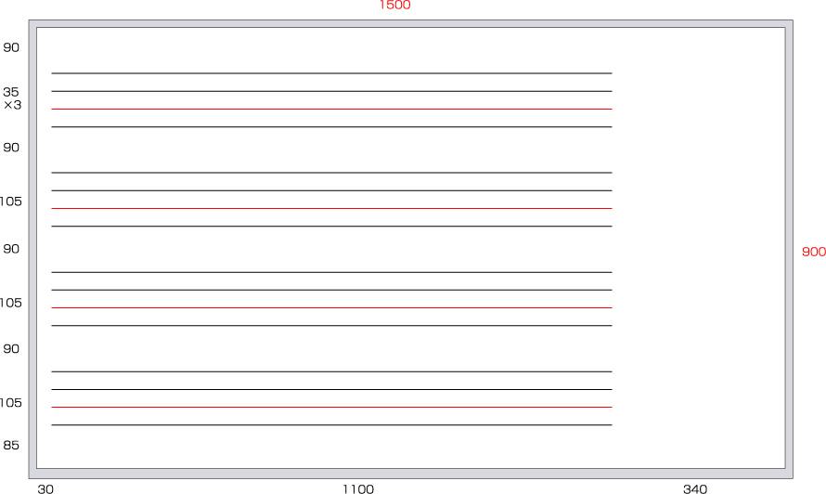


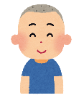

Name
When is your birthday?
My birthday is
I want ＿＿＿＿＿＿＿＿＿ for my birthday.
.
Name | Birthday | ほしいもの
 | (His / Her) birthday is
 | (His / Her) birthday is
 | (His / Her) birthday is
.
.
.

Slide 2
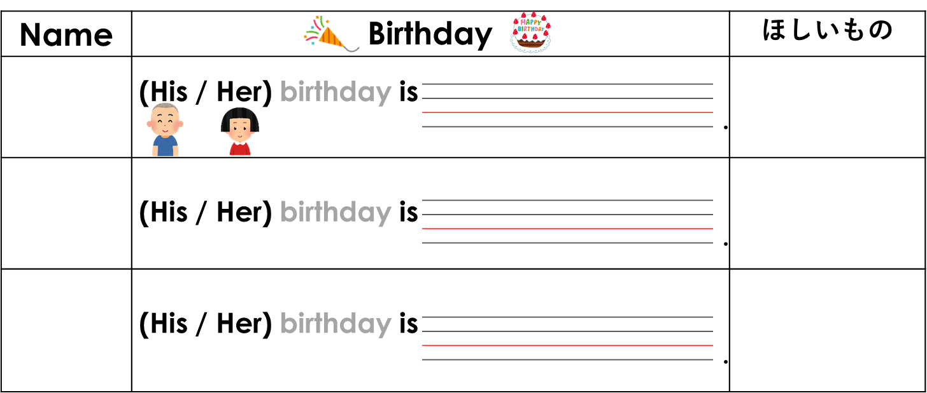
 | (His / Her) birthday is
 | (His / Her) birthday is
.
.

