Slide 1
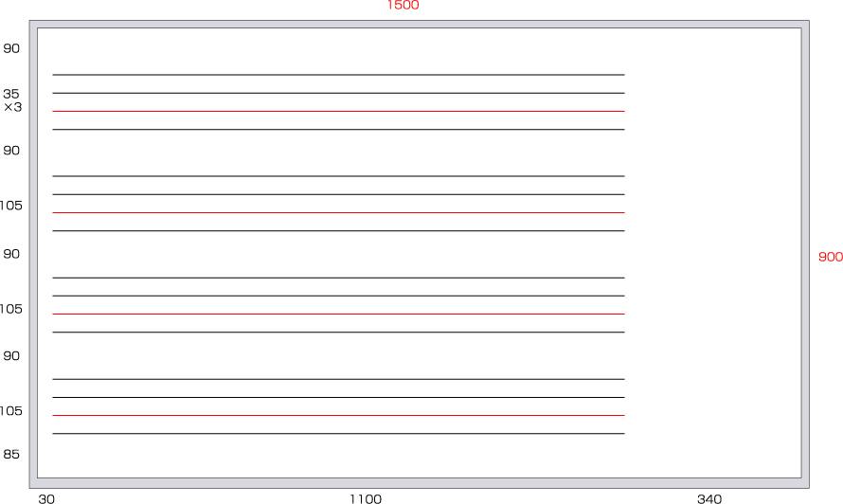
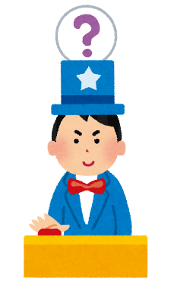

Quiz
Name ________________
( His / Her ) birthday is
( He / She) wants ________________ for
(his/ her) birthday.
( He / She) is _____________________.
( He / She) likes _____________________.
Hint 1
.
Hint 2
Hint 3
How many points did you get?

