Slide 1
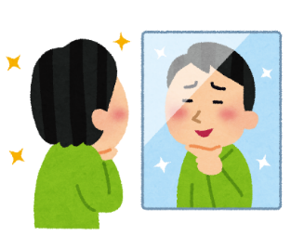




➀ I can ___________________________.
② I can ___________________________, but
③ I can’t ____________________________.
Me
name | ➀ | ② | ③ | can | can’t
Ex: Ayano | ✔ |  | ✔ | ・play volleyball ・swim | ・play baseball
Word bank
play soccer | play badminton | play kendama | do kendo | sing well | cook | ski
play baseball | play table tennis | play the recorder | do judo | jump high | skate
play shogi | play volleyball | play the piano | ride a unicycle | run fast | swim
Name_____________________

