Slide 1
be going to~
Tokoro Ayano

Slide 2


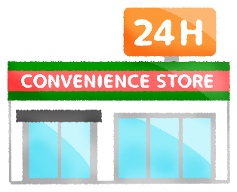
Step 1
(1) (2) (3)

Slide 3

Step2
(1) ( Are/ Do) you going to visit Nagahawa Firework Festival tomorrow?
-(Yes, I am. / No, I am not.) I can buy Yakisoba.
(2)( Are/Do) you going to visit Tokyo Tower next week?
-(Yes, I am. / No, I am not.) I want to stay home all day.
(3)( Are/Do) you going to visit a convenience store tomorrow?
-(Yes, I am./ No, I am not.) I want to buy fried chicken.

Slide 4
Step3 Grammer points
1, I’m going to visit Tokyo Tower next week.
訳（ ）
★I ＋( ) ＋ ( ) ＋ to ＋（ ）で私は
（ ）ですという意味になる。
( ) ＋ you ＋ ( ) ＋ to ＋（ ）？で
（ ）ですかという意味になる。
答え方 Yes, ( ) ( ) No, ( ) ( ) ( )
💡am=be動詞
私は来週東京タワーに行く予定です。
am
going
動詞の原形
～するつもり
Are
going
動詞の原形
～するつもり
I
am
I
am
not

Slide 5
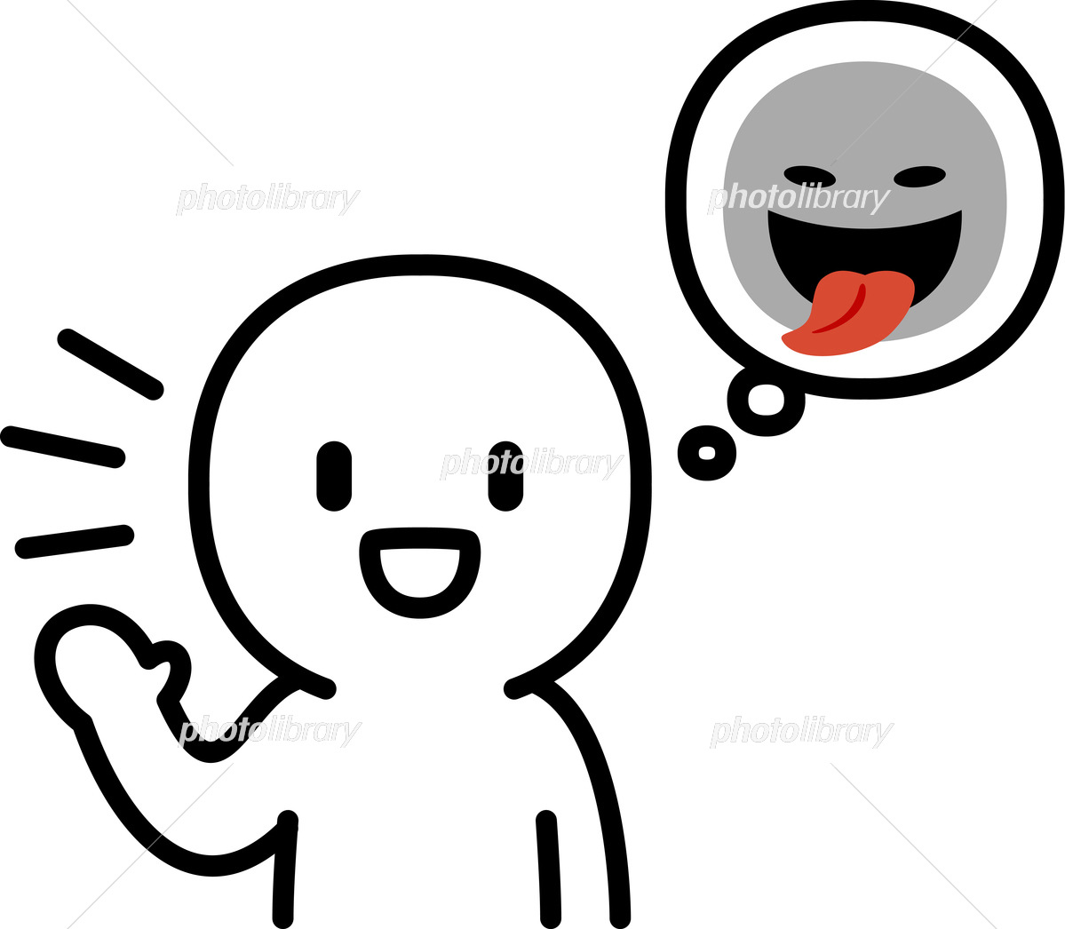
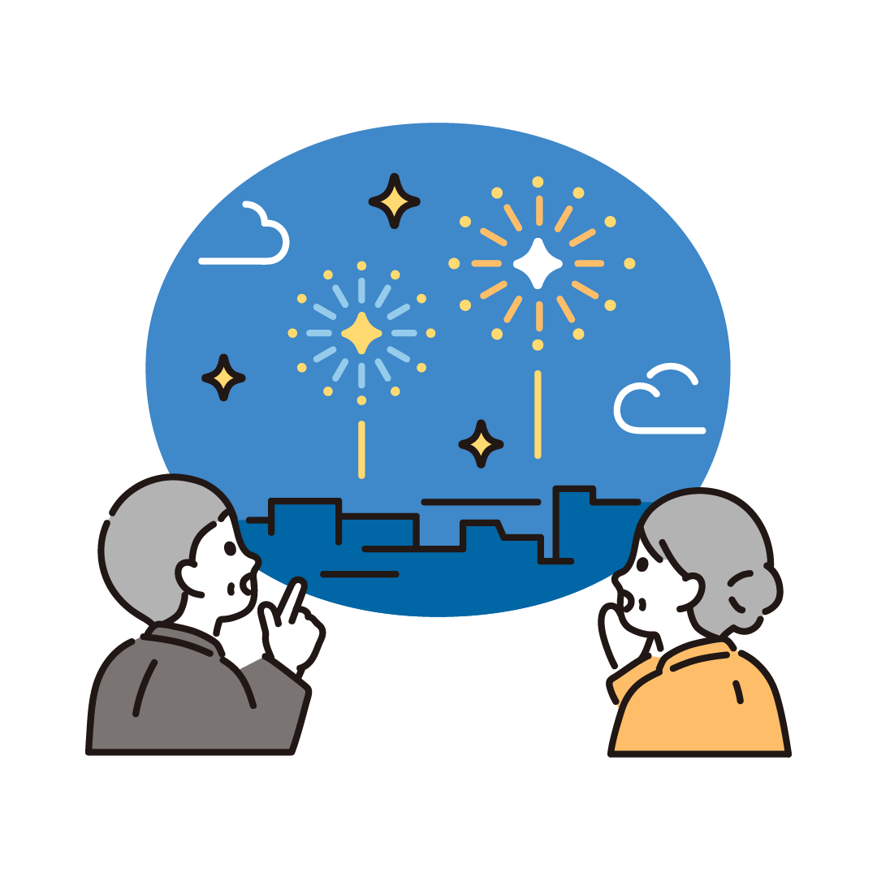
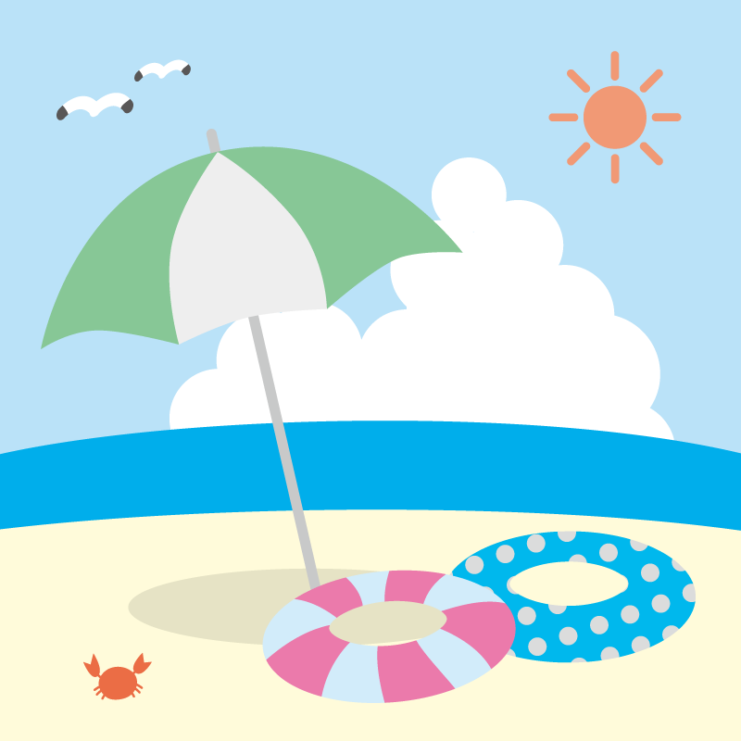
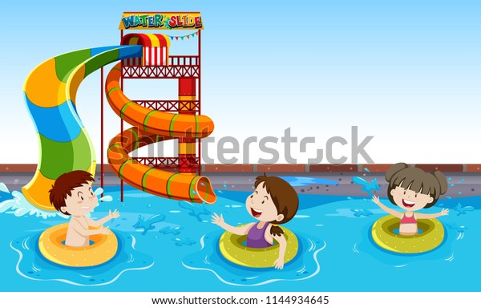
Step4 preparation for activities!
(1)Please write down three your plan during summer vacation!
(Only One you write false information.)
(2) Don’t show your partner.

Slide 6
Key words
vocabulary | meaning
Visit | 訪れる
Take a picture | 写真を撮る
Buy | 買う
Go shopping | 買い物に行く
Eat | 食べる
leave | 去る

Slide 7

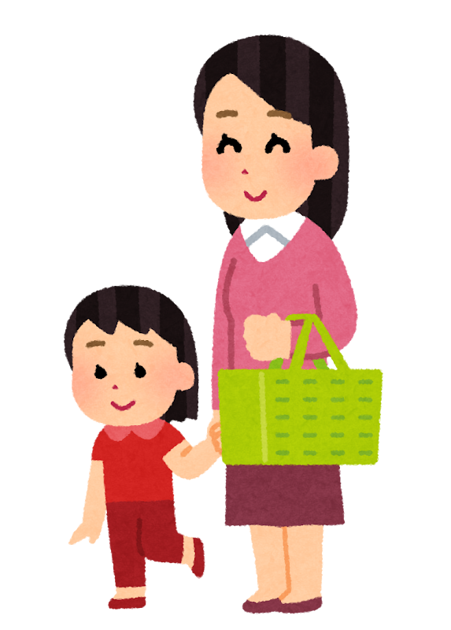
～For example～
I’m going to visit Nagashima Spa Land during the summer vacation.
(2)I’m going to talk with Prime Minister during the summer vacation.
(3)I’m going to go shopping with my family during the summer vacation.

Slide 8
Step5 Find the false thing!
You will use 3 sentences you made in step4 !
(2) Follow the model dialog!
(3) I will show demonstration how.

Slide 9
Thank you for coming!

