Slide 1


Slide 2

Sports
Tokoro Ayano

Slide 3

Today’s goal
タスクを通じて、
クラスメートの情報を聞き出そう！😏

Slide 4



Step1
① Just listen ②fill the blanks
🎵

Slide 5
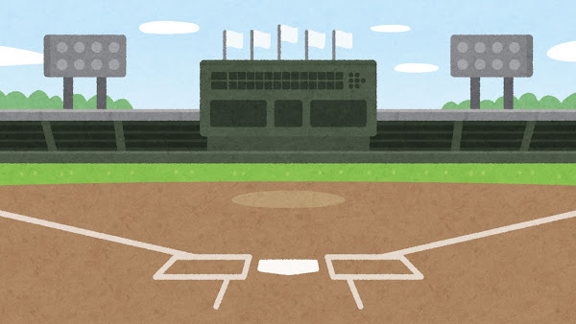
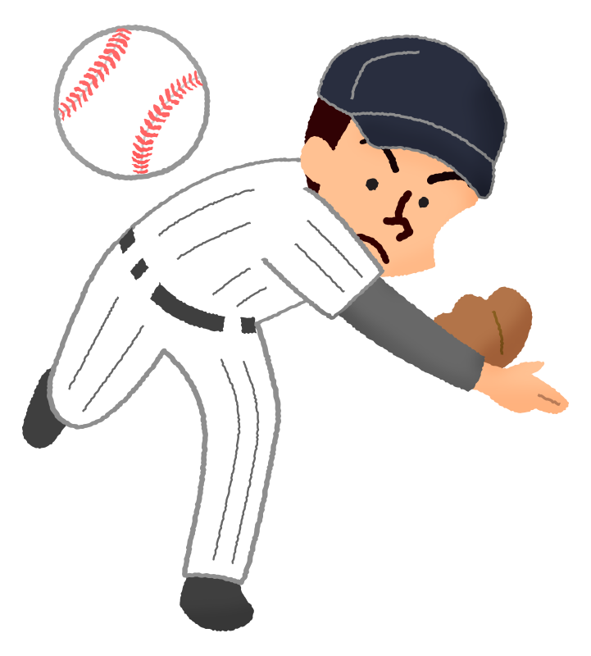

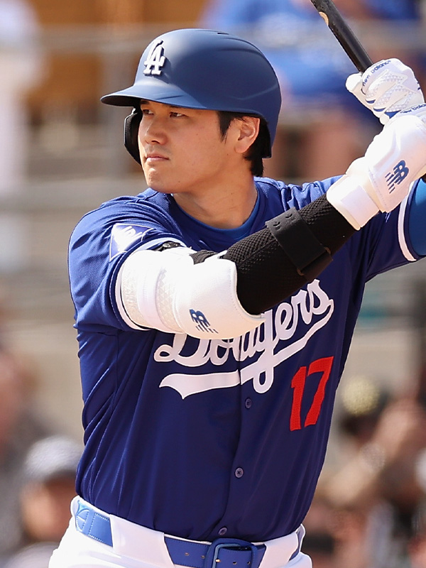

(1)

Slide 6
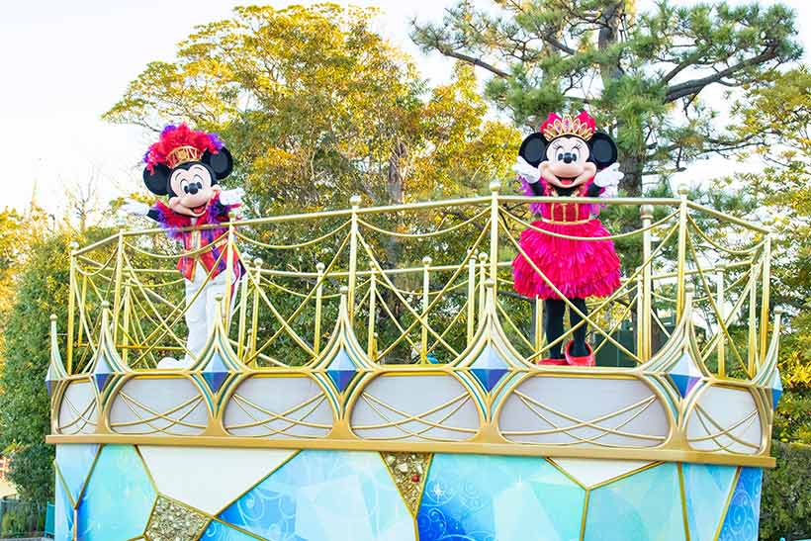
(2)

Slide 7
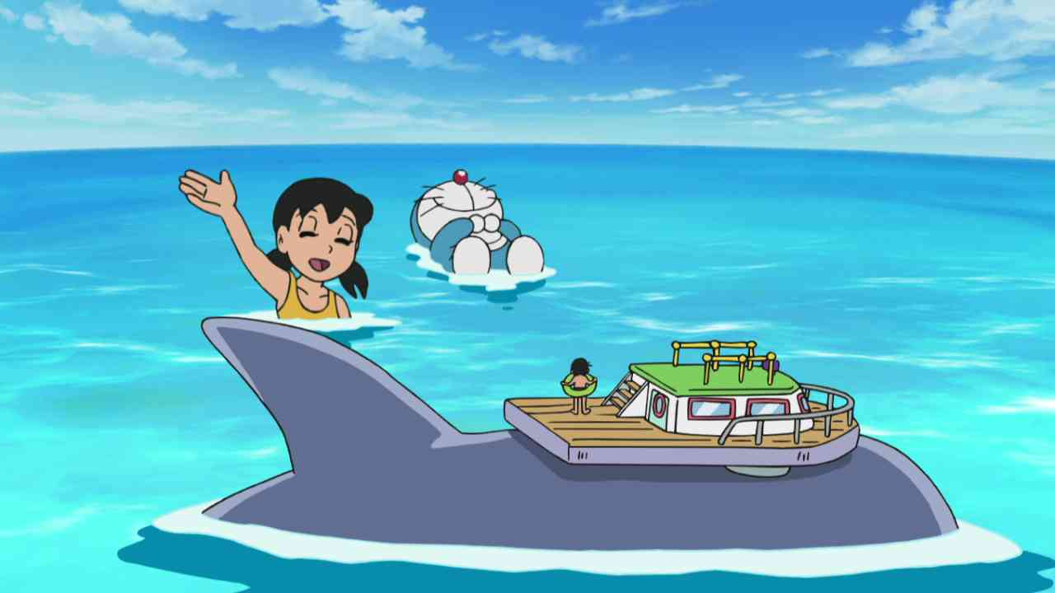
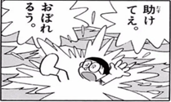
(3)

Slide 8

Step2 聞えた方に○をつけよう！
(1) A: Hello, Ayana. Did you watch the baseball tournament last night?
B: No, I didn’t. Why do you ask me the question?
A: Because I’m interested in Baseball. My favorite player is Otani.
（ It / that) is fun for me to ( watch / watches) baseball.
B: I think so too.

Slide 9
(2) A: Hello, Ayana. Have you ever watched the parade at
Tokyo Disney land?
B: Yes. I liked Minne’s performance.
A: I see. It ( is /was) important for Minnie to
(practice/ practiced) dancing for shows.
B: I think so too.

Slide 10

(3) A: Hello, Ayana. I want to go to the sea with Doraemon.
B: That’s nice, but it is not good for Nobita.
A: Why do you think so?
B: It is difficult (to/ for ) Nobita to swim well.
So, I want to go to the mountains.

Slide 11
Step3 Grammar points
○It is fun for him to play baseball.
訳 ( )
( ) ＋ is/was ＋ ( ) ＋人＋( )＋動詞の（ ）
または、書き換えることもできる。
★Studying math is difficult for me.
訳( )
= ( ) is difficult ( ) me ( ) ( ) math

Slide 12
Step3 Grammar points
○It is fun for him to play baseball.
訳 (彼にとって野球をするのは楽しいことだ。)
( It ) ＋ is/was ＋ ( 形容詞 ) ＋for ＋人＋( to )＋動詞の（原型 ）
または、書き換えることもできる。
★Studying math is difficult for me.
訳 (数学の勉強は私にとって難しい。)
= ( It ) is difficult ( for ) me ( to ) ( study ) math

Slide 13
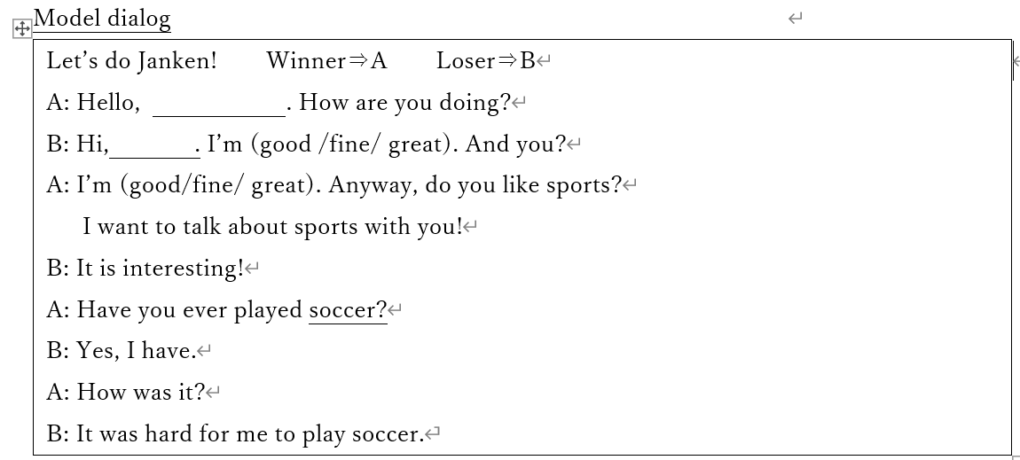

Step4 Let’s start Bingo game!
①例を参考にしてパートナーに質問しよう！
形容詞に注目！！

Slide 14
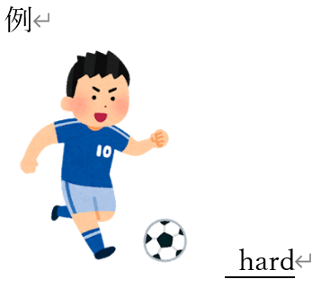
②そしてあてはまる形容詞をビンゴ
カードに書こう！

Slide 15
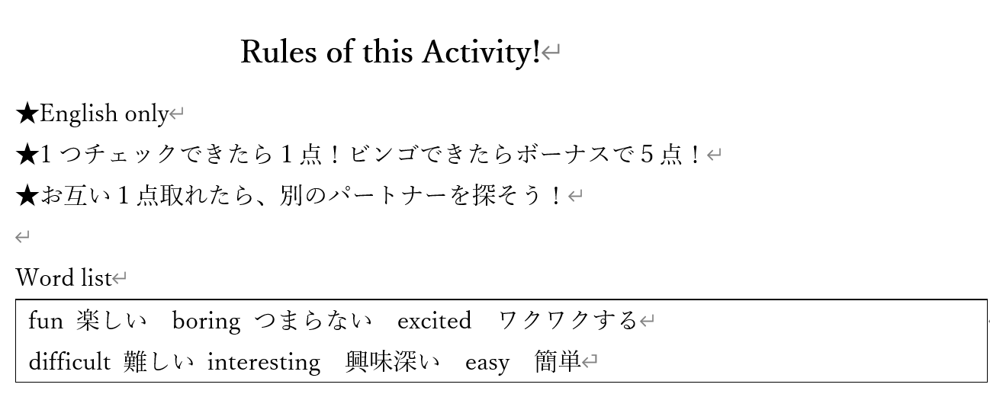

Slide 16
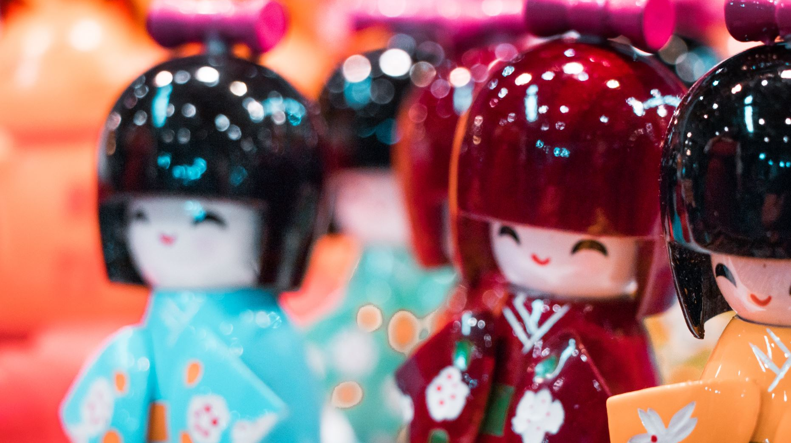
~Happy New year~
Thank you for coming!

