Slide 1
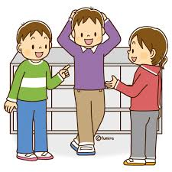
Let’s ask classmates!

Slide 2

Today’s goal !
クラスメートにして欲しいことを話せるようになろう
Be able to talk about what you want your classmates to do

Slide 3
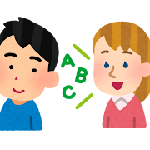

Step1 Let’s write what you listen to
①you only listen to my story
② you write your worksheet what you listened to

Slide 4





Slide 6
Name | してほしいこと
Yuto
Yuka
ギターを
弾いてほしい
数学を
教えてほしい

Slide 7
Step2 Let’s fill the blanks listening again
Just once

Slide 9
A: Hi. Yuka. How’s it going?
B: Hi, Yuto. I’m good. How about you?
A: I’m good, too. By the way, you are good at playing the guitar.
I want ( )( )( ) the guitar.
B: Yes, of course.
+
A: Thank you! Yuka. What are you doing now?
B: I’m studying math. It is difficult for me.
I ( )( )( )( ) math.
A: Yes, I can.
B: Thank you!
you to play
want you to teach

Slide 10
Step3 Grammar Point
I want you to get up early
(訳： )
＜want ＋（ ）＋to＋（ ）＞
私はあなたに早く起こしてほしい
人
動詞の原形

Slide 11

Step4 Let’s tell classmates
what you want to !

Slide 12
＜Model dialogue＞
A: Hi, ( Yuka ). How’s it going?
B: Hi, ( Yuto ). I’m ( good ). How about you?
A: I’m good. Please tell me what you want classmates to do.
B: I want ( Yuka ) to ( play the guitar).
A: Why do you think so?
B: Because ( she is good at playing the guitar ). ←reason
A: ( That’s nice ). ←conversation strategies
※Changing roles

Slide 13
Name: Yuka
I want ( her ) to play the guitar.
Reason: She is good at playing the guitar.

Slide 14
Tips
teach English 英語を教える make a cake ケーキを作る
put away the desk 机を片付ける show the pictures 写真を見せる
open the window 窓を開ける draw a picture 絵を描く
close the window 窓を閉める play the piano ピアノを弾く
Communication Strategies
・Yes. Uh-huh. That's right.
・Oh, really? Wow!
・Me, too! That's interesting! That's great!

Slide 15
Step5 Let’s write a sentence you learned
today’s class
I want Yuka to play the guitar.

Slide 16
Today’s goal !
クラスメートにして欲しいことを話せるようになろう
Be able to talk about what you want your classmates to do

