Slide 1
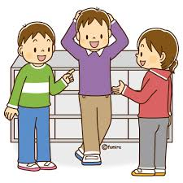
Let’s ask classmates!

Slide 2

Today’s goal !
クラスメートの習慣を知ろう
Be able to learn about the habits of your classmates

Slide 3
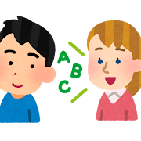
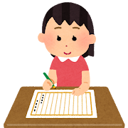
Step1 Let’s write what you listen to
①you only listen to the conversation
② you write your worksheet
what you listened to

Slide 4

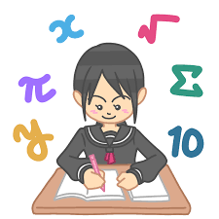
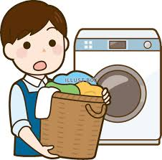
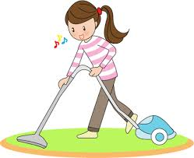

Slide 6
 | しなければならない | しなくてもよい
Yuto
Yuka
理科を勉強する 洗濯をする
部屋を掃除する 数学を勉強する

Slide 7
Step2 Let’s circle the one
you listen to
( A/B )
〇

Slide 8
A: Hello, Yuka. How are you?
B: Hello, Yuto. I’m fine. How about you?
A: I’m not good because I ( have to ) ( have ) study science.
B: Oh, I see. Today, I had a math test,
so I ( don’t have to ) (amn’t have to ) study math.
A: That’s good. Every Wednesday, my sister washes clothes,
so I don’t ( have to ) ( have ) wash clothes today.
B: I see, but I have ( to clean ) ( clean ) my room today.
A: Wonderful!
〇
〇
〇
〇

Slide 9
Step3 grammar point
I have to study science.
(訳： )
肯定文：I（ ）（ ）（ ）～.
訳：私は～をしなければならない。
否定文：I（ ）（ ）（ ）（ ）～.
訳：私は～をしなくてもよい。
私は理科を勉強しなければならない。
have to 動詞の原形
don’t have to 動詞の原形

Slide 10

Practice：週末にすること・しないこと
※have to, don’t have toを使って
すること：＿＿＿＿＿＿＿＿＿＿＿＿＿＿＿＿＿＿＿＿＿＿
しないこと：＿＿＿＿＿＿＿＿＿＿＿＿＿＿＿＿＿＿＿＿＿
I have to study English.
I don’t have to clean my room.

Slide 11
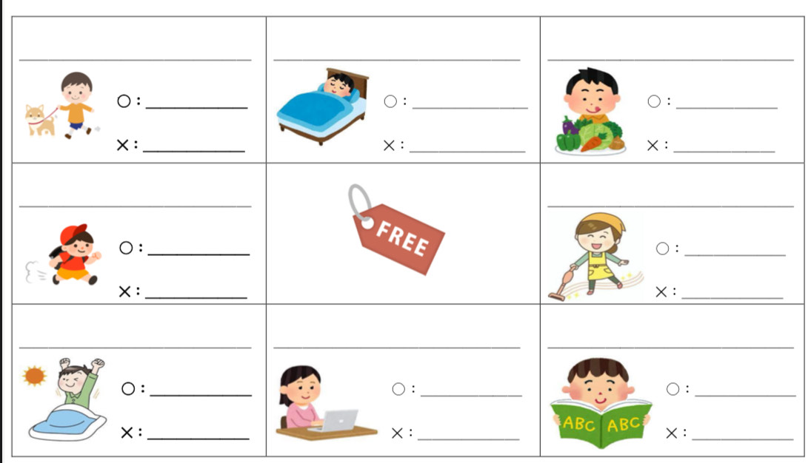
Step 4 Let’s play BINGO!
How to play
You make “have to” or “don’t have to” lines. ※have to-〇, don’t have to－✕
walk your dog
Tips
walk your dog,
clean your room,
eat vegetables,
use your computer,
run,
study English,
get up early,
go to bed early

Slide 12
walk your dog go to bed early eat vegetables
Model dialogue
Winner-A, Loser-B
A: Hello, ( ).
How are you?
B: Hello, ( ). I’m fine.
How about you?
A: I’m good.
Do you have to clean your room?
B: Yes, I do. / No, I don’t.
A: That’s great! ←Rejoinders
run clean your room
Taiyo
get up early use your computer study English
Taiyo
Rejoinders
うなずく：I see.
コメント：That’s great!/Wonderful!
驚き：Wow!/Really?
〇lines

Slide 13
Step 5 今日学んだ表現を書こう！
I have to get up early.
＿＿＿＿＿＿＿＿＿＿＿＿＿＿＿＿＿＿＿＿＿＿＿＿＿＿＿＿＿＿＿＿＿＿＿＿＿＿＿＿＿＿＿

Slide 14
Today’s goal !
クラスメートの習慣を知ろう
Be able to learn about the habits of your classmates

