Slide 1
Let’s make a plan!
Takehiro Asai

Slide 2
Step1 Complete the table below
Rule
・First, you have to watch video only, you must not see your worksheet.
・Second, you can write your answers on your worksheet.(Please do not look at Step 2)

Slide 3
Step1
Weekend plan
(1)What are they going to do?
(2)Where are they going to go?
They are going to watch new Zibri movie.
They are going to go the new movie theater near a hospital.

Slide 4
Step2. Please make a circle on the correct answers and fill in the blanks.
( Have / Has ) you already ( decide / decided ) what you are going to do next weekend?
→ Yes, I ( have / has )
Have you ( already / yet ) ( watched / watch ) this new movie?
→ No, I ( have / haven't )
Have you already ( be / been ) to a new theater near the hospital?
→ No, I ( haven’t / have ) .
I’ve ( ) ( ) tickets for us
already
bought

Slide 5
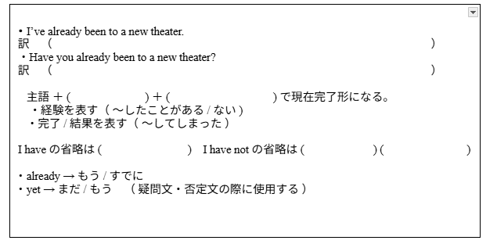
Step3 Grammar point
私はすでに新しい映画館に行ったことがあります。
あなたはすでに新しい映画館に行ったことがありますか。
have
動詞の過去分詞
I’ve
I
haven’t

Slide 6
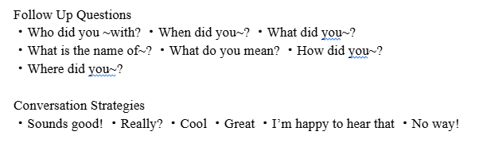
Step4. Activity Bingo

Slide 7
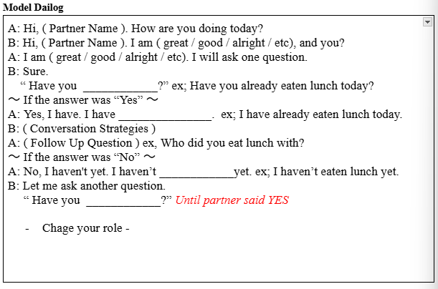
Step4.

Slide 8
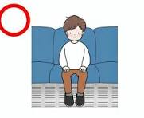
Step5. Writing
Example:
Have you already eaten lunch today?
I’ve already been to a new theater

