Slide 1
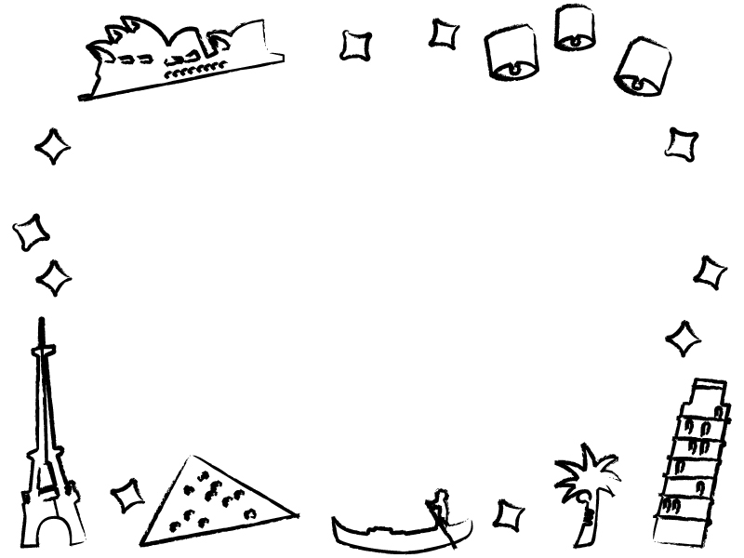


My favorite place
Tokoro Ayano

Slide 2
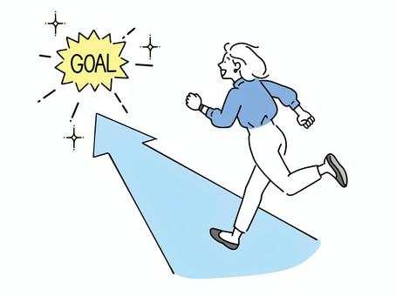
Today’s goal
クラスメートに自分の好きな場所を紹介しよう❗

Slide 3

We have speaking test and fun essay!
★Speaking test
2 minutes
Choose your partner randomly
★Fun essay
Use one picture or draw an
illustration
＋
Introduce Japanese culture

Slide 4
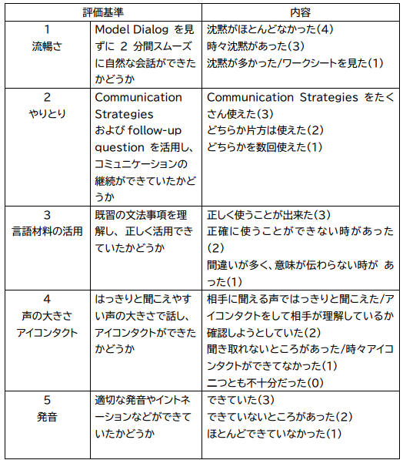
＜Evaluation criteria> speaking test

Slide 5
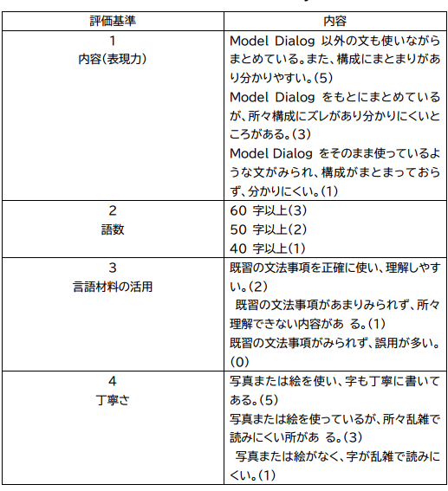
<Fun essay>

Slide 6
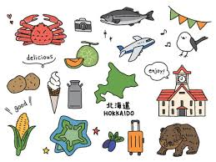
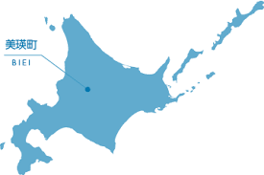
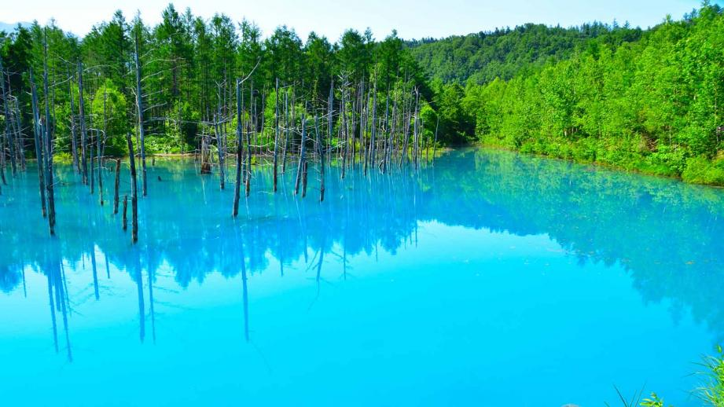
Step1(1)2人の会話を聞いて質問に答えよう!
Blue pond 青い池

Slide 7
(2)4つの質問に文で答えよう！
（1）How many times has Ayano been to Hokkaido?
(2) Has she ever been to Biei?
(3) What can she do in Biei?
(4) Is she going to go to Hokkaido with Takehiro?

Slide 8
～答え合わせ～
（1）How many times has Ayano been to Hokkaido?
She has been to Hokkaido twice.
(2) Has she ever been to Biei?
No, she hasn’t. It is my first time to go to Biei.
(3) What can she do in Biei?
She can see a blue pond in biei.
(4) Is she going to Hokkaido with Takehiro?
She is going to go to Hokkaido with Takehiro.

Slide 9
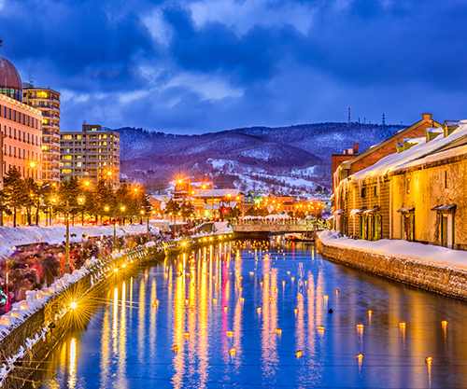

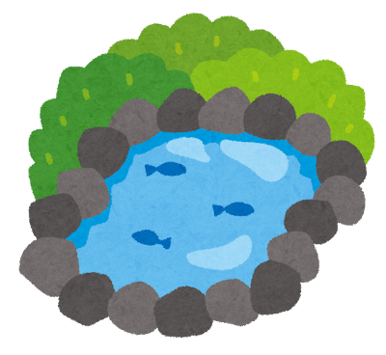

Step2 マインドマップを作ろう！
③そこで何ができる？
③I can see a blue pond.
②twice
①Hokkaido
②何回いったことあるか
①お気に入りの場所
④ eat soft cream.
他に何ができる？

Slide 10

Step3 文で書いて見よう
① Where is your favorite place?
My favorite place is Hokkaido.
② How many times have you been there?
I have been there twice.
③ what can you do there?
You can see a blue pond there.
④ What else can you do there?
You can eat soft cream.

Slide 11
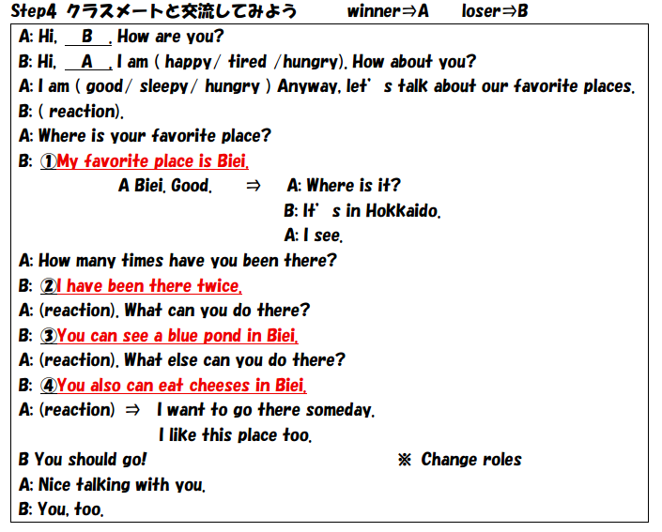
Step4 Let’s talk with classmates!
Really? / Wow! / That’s great! / Nice / Sounds interesting!
Uh, huh. / I see. / Good! / Amazing! / Me, too. / Do your best!

Slide 12
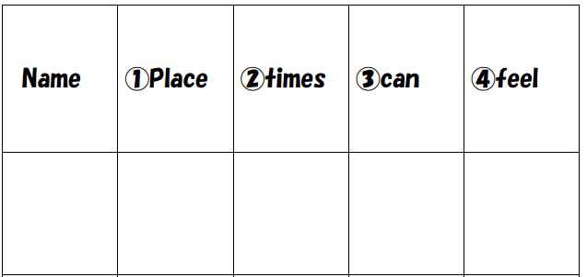
Memo
相手の気持ちを読取って表現してみよう
See a blue pond
Ayano
Hokkaido
twice
exciting
Eat soft cream

Slide 13
気持ちを表現する英語
Fun
楽しい
Boring
つまらない
Tired
疲れる
Interesting
面白い
Sleepy
ねむい

Slide 14

Thank you for coming!

