Slide 1
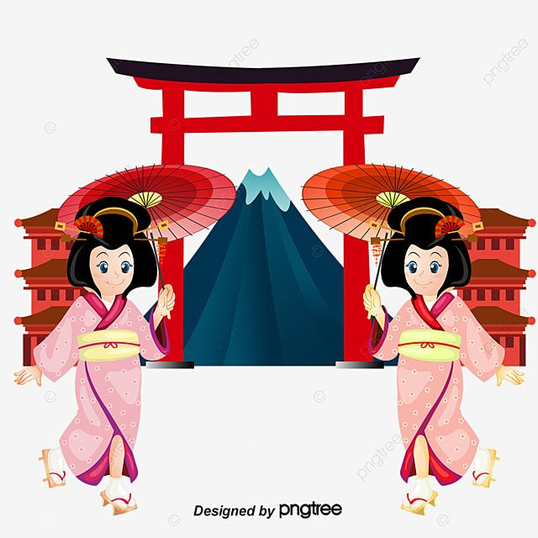
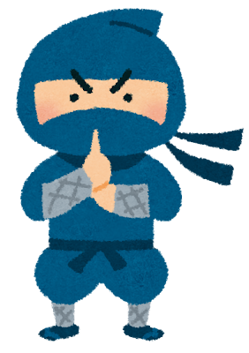
Japanese culture
22011021
Tokoro Ayano

Slide 2

Today’s goal
タスクを通して日本文化について紹介することができる

Slide 3

We have speaking test and fun essay!
★Speaking test
2 minutes
Choose your partner randomly
★Fun essay
Use one picture or draw an
illustration
＋
Introduce Japanese culture

Slide 4
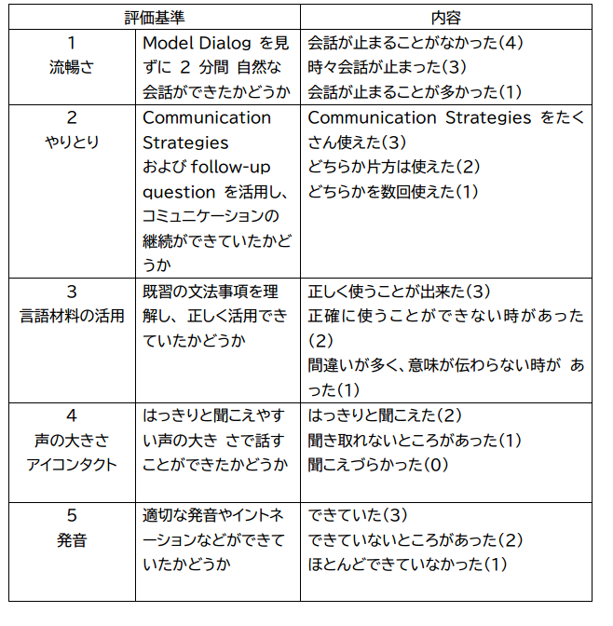
<Evaluation criteria>
Speaking test

Slide 5

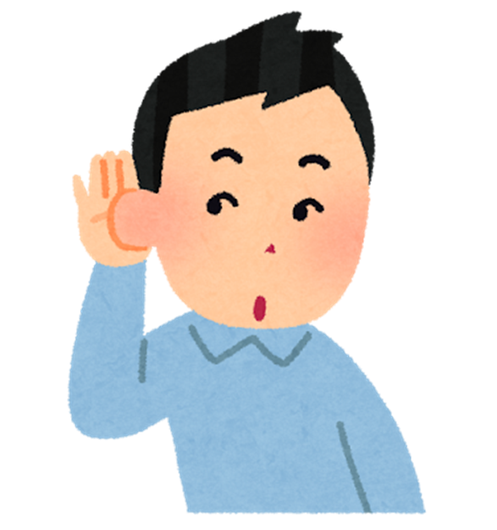

Step1(1) トムの好きな日本文化💕
(1)Just listen (2) Read the story with
your partner by comma.

Slide 6

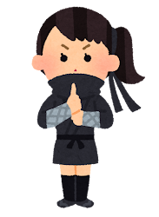
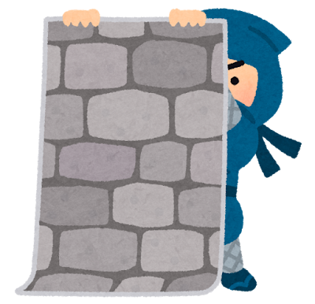




12th century

Slide 7
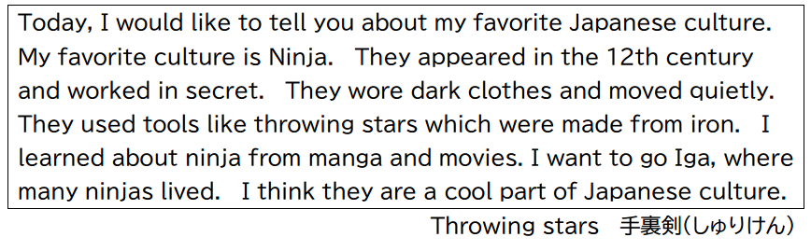

Slide 8
(2) Answer the questions
Q1 What does Tom want to introduce?
Q2 When did ninja appear?
Q3 What kinds of tools did ninja use? (＋whichも使おう！）
Q4 Where does Tom want to go? (＋whereも使おう！）
Q5 what does Tom think about ninja?

Slide 9
(2) Answer the questions
Q1 What does Tom want to introduce?
He wants to introduce ninja.
Q2 When did ninja appear?
They appeared in the 12th century.
Q3 What kinds of tools did ninja use? (＋whichも使おう！）
They used tools like throwing stars which were made from iron.

Slide 10
Q4 Where does Tom want to go? (＋whereも使おう！）
He wants to go Iga, where many ninjas lived.
Q5 what does Tom think about ninja?
He thinks they are a cool part of Japanese culture.

Slide 11





Step2 Let’s make a mind map💡
③それが有名な場所だったり行きたい場所
②Used
A bucket
Visit Matsuyama
②どんな道具を使う
Hot springs
①いつあらわれた
A symbol
①Appeared in the
7th century
④どう思う？

Slide 12
Step3
Answer the following questions using Mind map
Q1 What do you want to introduce?
I want to introduce hot springs.
Q2 When did they(it) appear?
It appeared in the 7th century.
Q3 What kinds of tools did they (it) use?
They used a bucket which made from wood.

Slide 13
Q4 Where do you want to go ?
I want to visit Matsuyama where there are the oldest hot spring in Japan.
Q5 What do you think about them (it)?
I think hot springs are a symbol of Japanese culture.

Slide 14
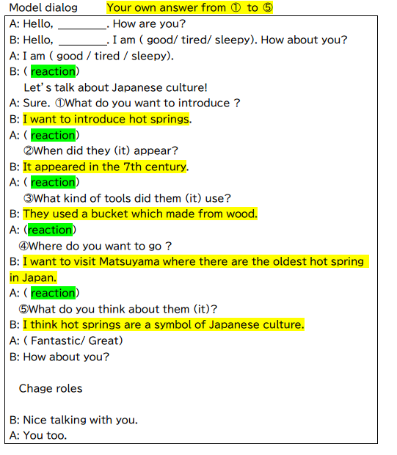
Step4 Practice for Speaking test!
★Reaction
Really? / Wow! / That’s great! / Nice / Sounds interesting!
Uh, huh. / I see. / Good! / Amazing! / Me, too. / Do your best!

Slide 15
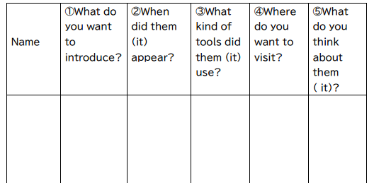
Memo
A bucket which made from
wood
Hot springs
The 7th century
Matsu
yama
a
symbol
Ayano

Slide 16

Thank you for coming!

