Slide 1
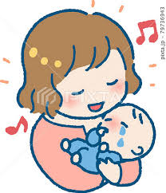

A Mother’s Lulllaby

Slide 2

Today’s goal !
本文の流れを捉えることができるようになる！
Be able to grasp the flow of the text.

Slide 3

Step 1 Let’s guess
Look at the title and nine pictures. Please guess the story in Japanese.

Slide 4

Step 2 Q&A
Look at the nine pictures. Answer the following questions.

Slide 5
1. What did the girl and her mother do under the tree?
Her mother sang her a lullaby.
2. Why was the tree sad?
Because it reminded people of the day
the atomic(=big) bomb fell.

Slide 6
3. What happened to the many people under the tree?
They fell down because of the atomic bomb.
4. Were the girl and the little boy alive the next morning?
No, they weren’t.

Slide 7
Step 3 Words Check!
英文を読んで、イラストをマッチさせよう
1. A mother is singing a lullaby to her son. ( )
2. People were injured because of the car accident. ( )
3. We rest in the shade. ( )
4. His body is weak. ( )
d
e
a
c

