Slide 1
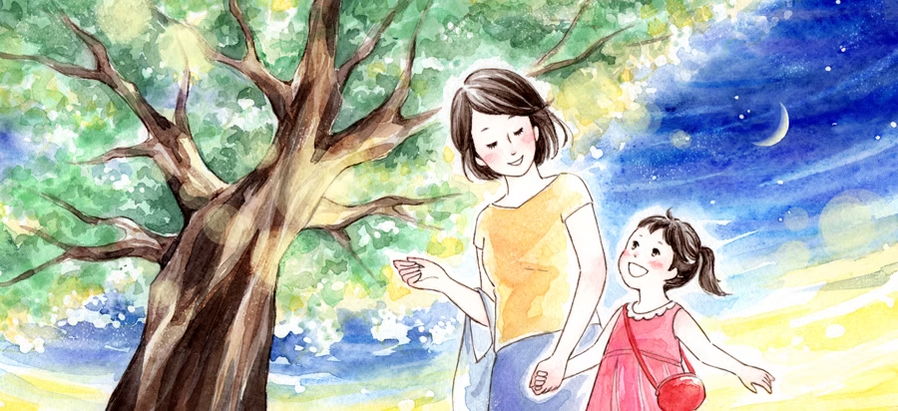
A Mother’s lullaby②
Tokoro Ayano

Slide 2
今日のgoal
タスクを通して本文の内容や単語を理解して表現することができる

Slide 3
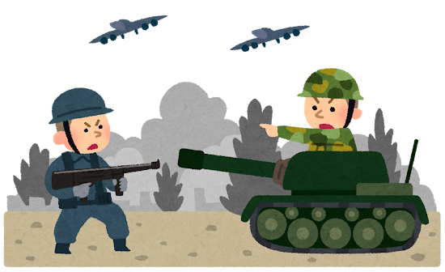
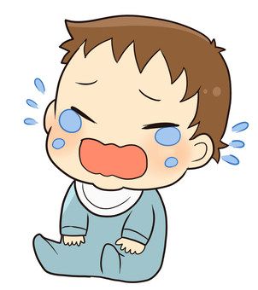
Let’s review ★
Do you remember what we did last class?

Slide 4
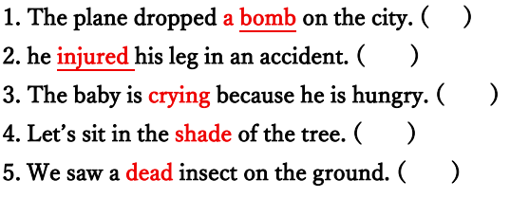
Step4 Word check

Slide 5
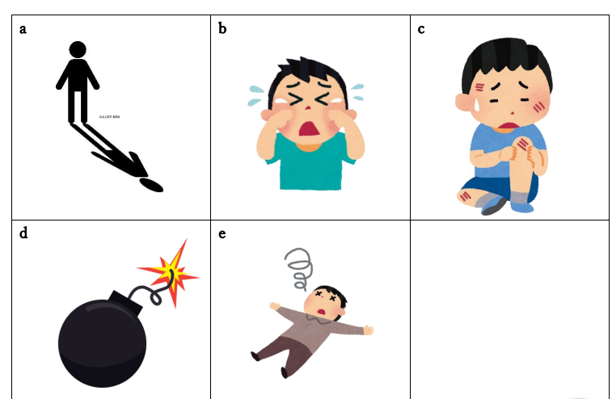

Slide 6
Step4 Word check
d
c
b
a
e

Slide 7
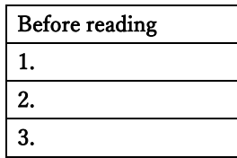
Step5 Let’s read ( ⚠Don’t open the textbook)
Many people lost their lives because of the big bomb.
A little boy was singing a lullaby.
3. A young girl tried to be a boy’s mother.

Slide 8


Reading time❗
Open the textbook and read silently.

Slide 9
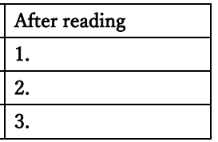
Step5② Answer the questions!
1.Many people lost their lives because of the big bomb.
2.A little boy was singing a lullaby.
3. A young girl tried to be a boy’s mother

Slide 10
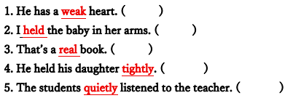
Step6 Word check③

Slide 11
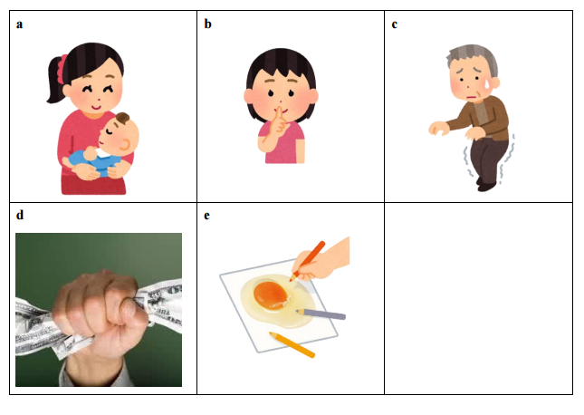

Slide 12
Step6 Word check③
c
a
e
d
b

Slide 13

Step7 Let’s open the textbook again 📖
Let’s try janken. ✊
The winner will start !
Take turns for each paragraph.✨

Slide 14
Answer the questions!
Where did the bomb fall?
2. What did they have on their bodies?
3. Was the girl the real mother of the little boy?
4. What happened to the girl after she fell down?

Slide 15
Answer the questions!
Where did the bomb fall?
2. What did they have on their bodies?
3. Was the girl the real mother of the little boy?
4. What happened to the girl after she fell down?
It fell on the city of Hiroshima.
They had burns all over their bodies.
No, she was not.
She never moved again.

Slide 16

Step8 reading practice

Slide 17

Thank you for coming today’s class!!

