Slide 1
Mother’s Lullaby
Takehiro Asai

Slide 2
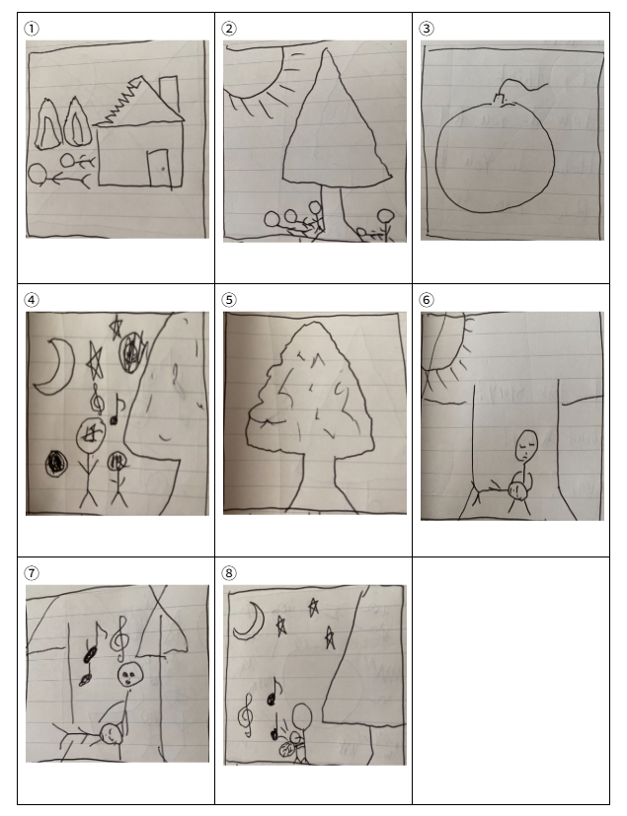
Step 1. Match the short summary and pictures!

Slide 3
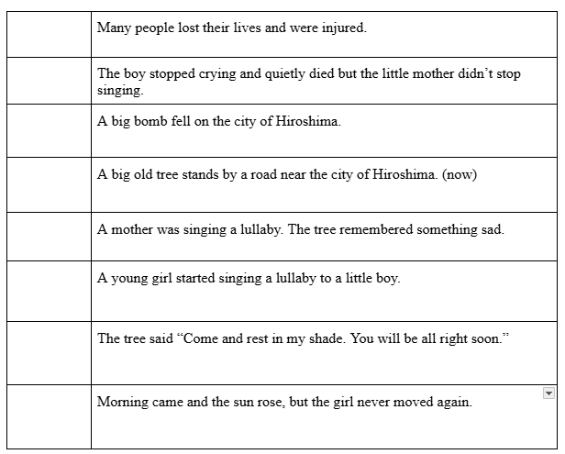
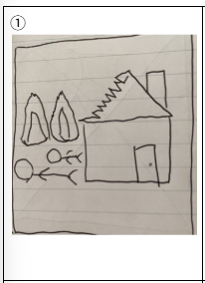
Step 1. Match the short summary and pictures!
①

Slide 4
Step 1. Match the short summary and pictures!
①
⑦
③
⑤
④
⑧
②
⑥

Slide 5
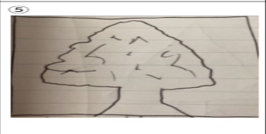
Put the pictures in the right order! ① to ⑧
First Last
⑤

Slide 6
Step 2. Let’s Talk
① How did you feel about this story? and why?
② Which scene was the most memorable? (let’s try to explain this scene in your own words)
③ Why did you choose this scene?
I felt very angry because people got hurt in the war.
The most memorable scene is when the girl sings a song to the boy.
Because I was impressed that the girl was helping the boy.

Slide 7
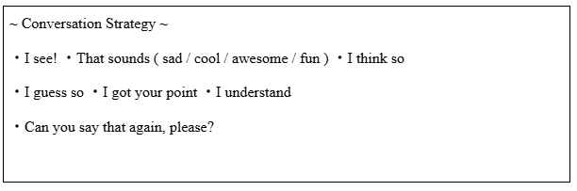
Step 2. Let’s Talk

Slide 8
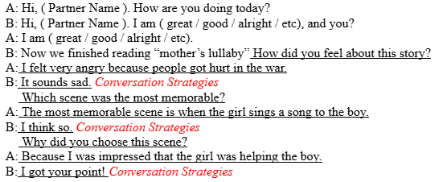
Step 2. Let’s Talk

Slide 9
3. Let’s write ~ Fun Essay~
Please write a Fun Essay on this topic.
What did you learn from this story?
Word count : 80

Slide 10
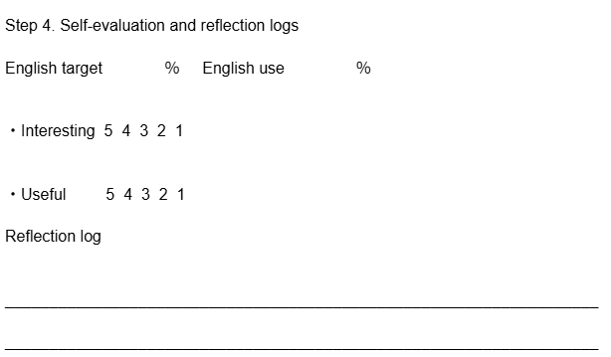
Step 4. Self-evaluation and reflection logs

