Slide 1
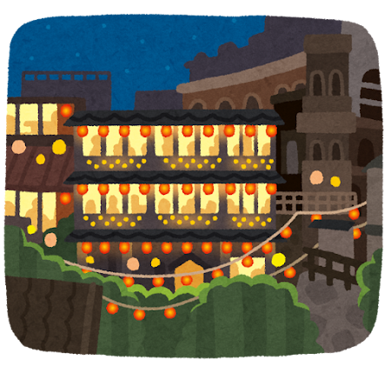
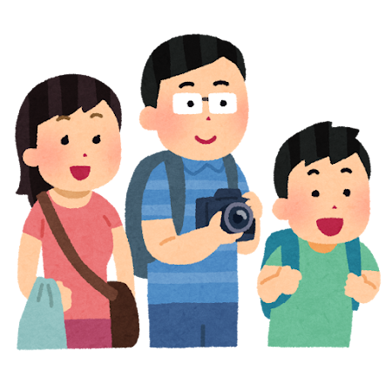

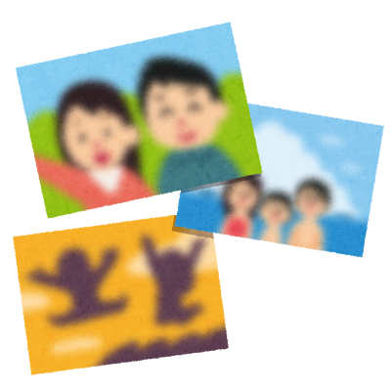

Memorable trip and environmental problem
22011033 Taiyo Fukaya

Slide 2
Goal
I can talk about a memory from a trip and think about the environmental issues in a tourist spot.

Slide 3
Small Talk
Where is a good place in Japan for a trip?
Use conversation strategies:
<That’s great! / That sounds great / Oh, I see. / Sounds interesting!>

Slide 4
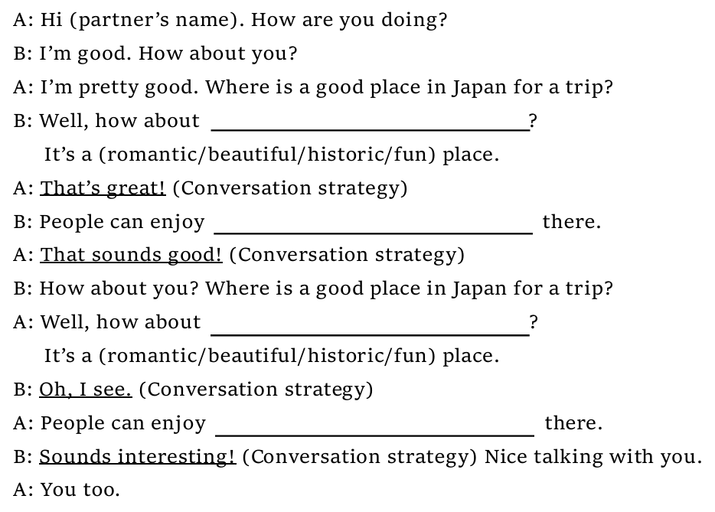
Listen to the model dialog
Mt. Fuji
beautiful view from the top

Slide 5
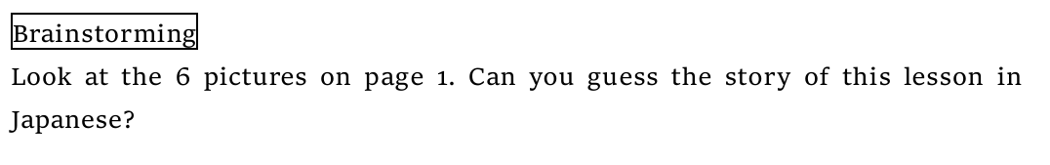
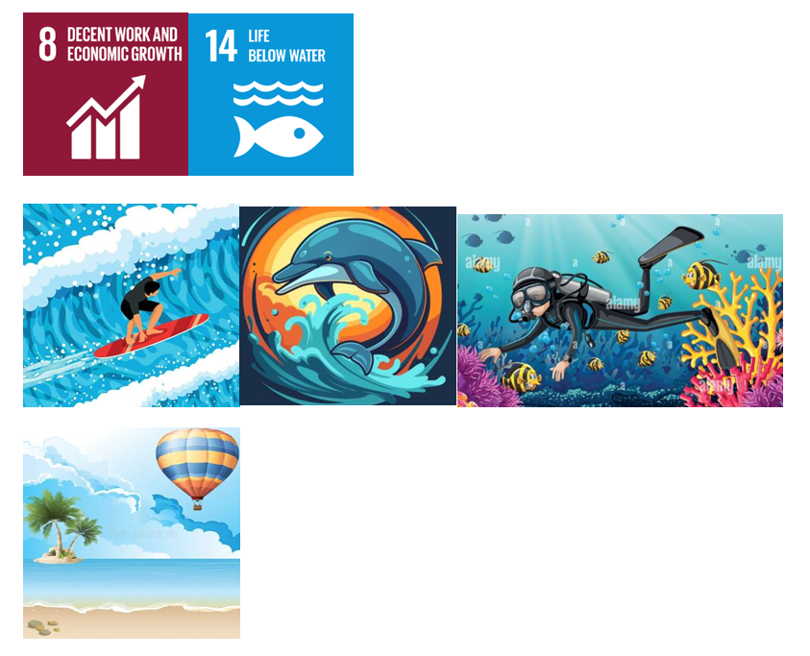

Slide 6
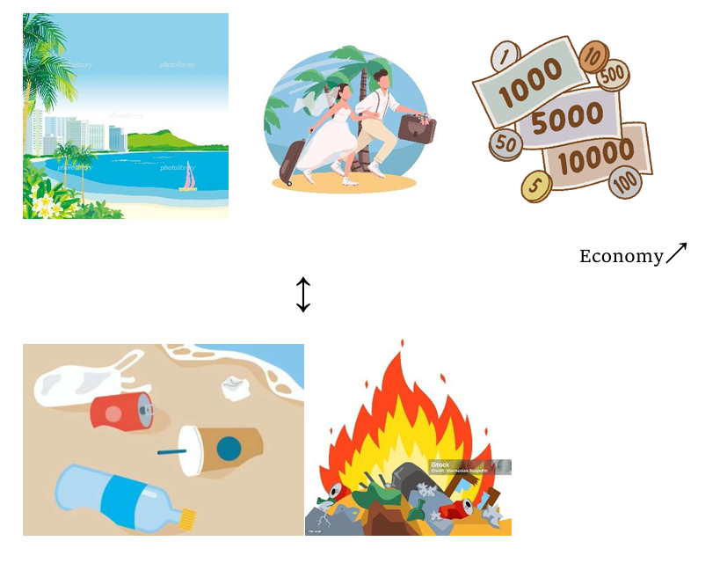

Slide 7
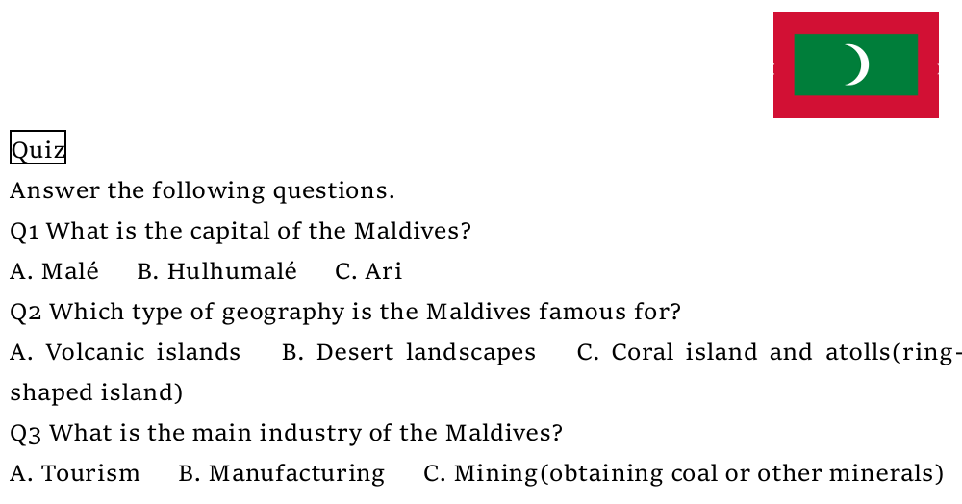

Slide 8
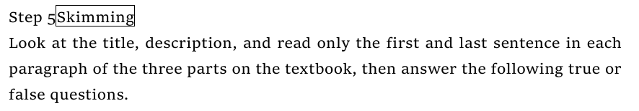
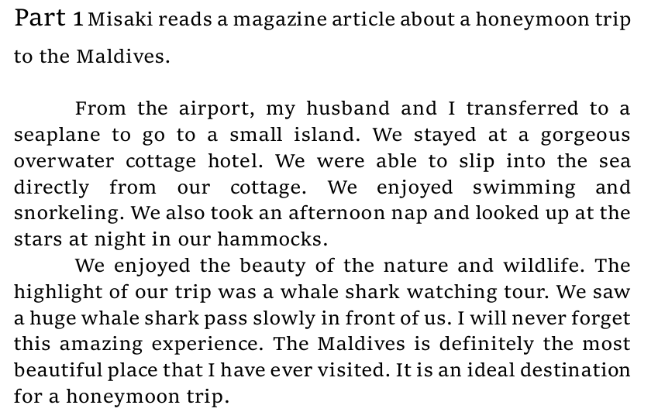

Slide 9
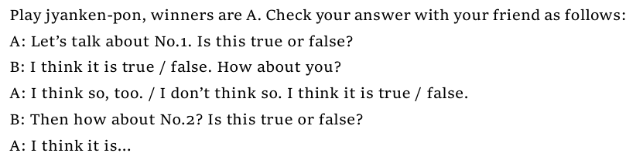

Slide 10
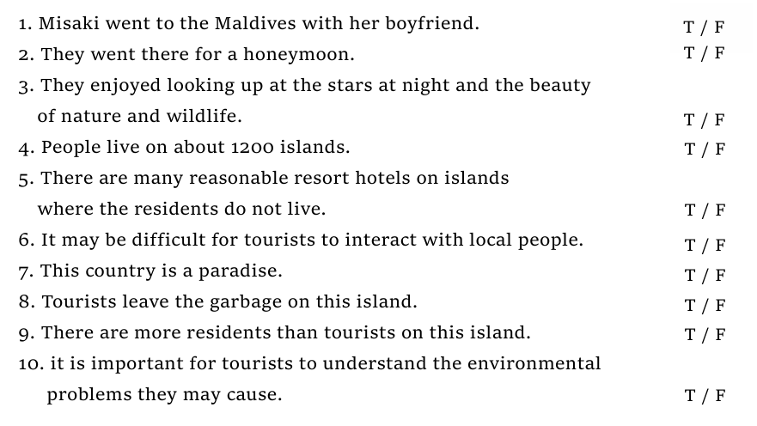

Slide 11
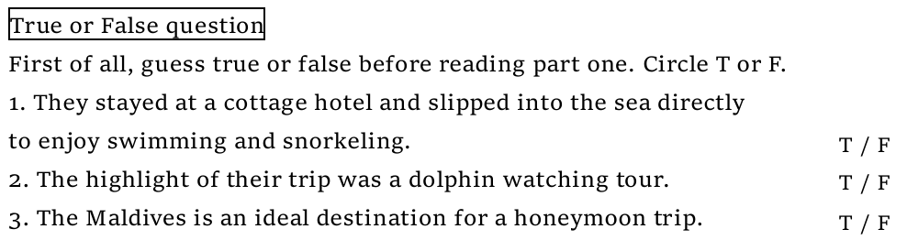

Slide 12
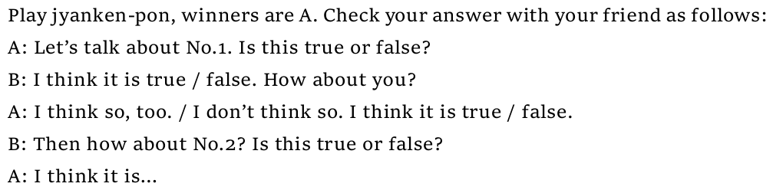

Slide 13
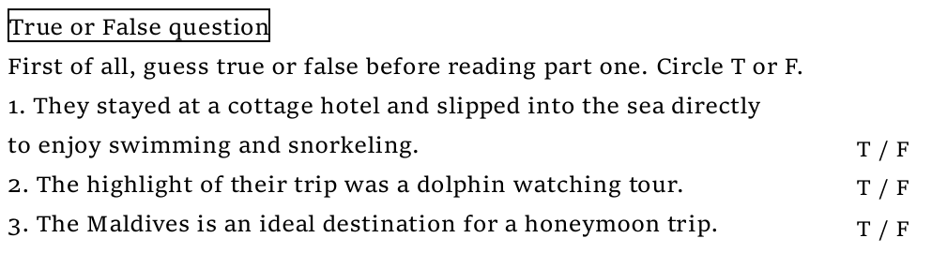
Whale

Slide 14
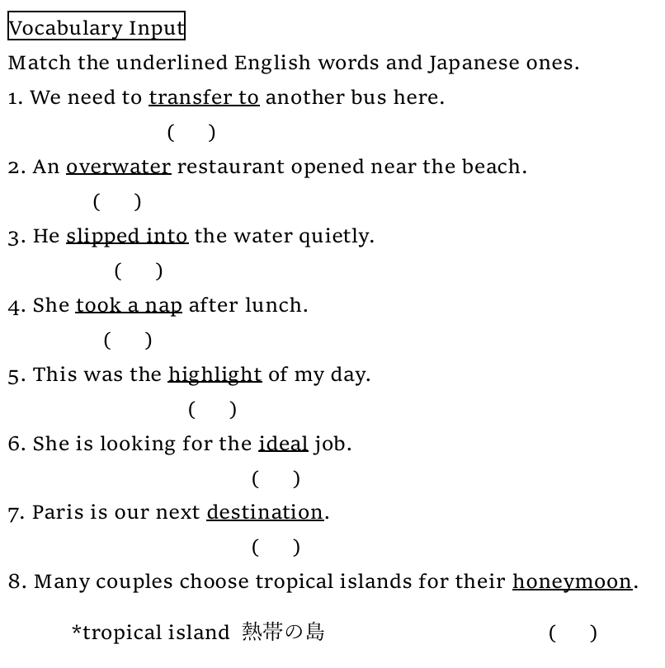
ウ
カ
キ
オ
ク
ア
エ
イ

Slide 15
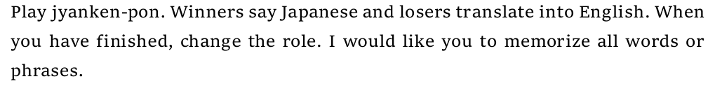

理想的な
…ideal

Slide 16
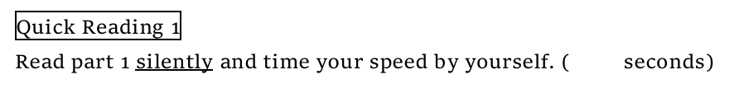

35

Slide 17
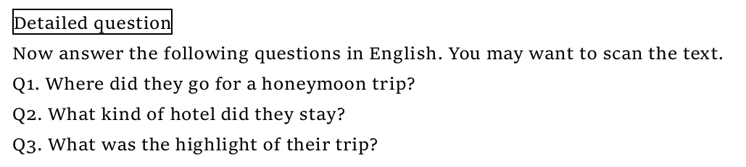
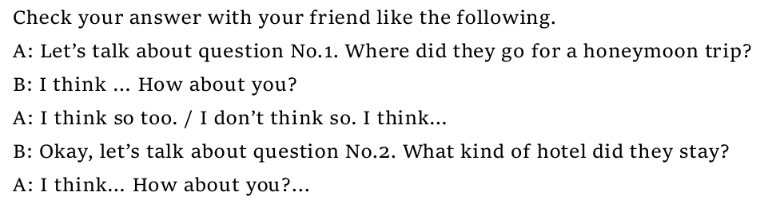

Slide 18
Q1. They went to the Maldives for a honeymoon trip.
Q2. They stayed at a gorgeous overwater cottage hotel.
Q3. The highlight of their trip was a whale shark watching.

Slide 19
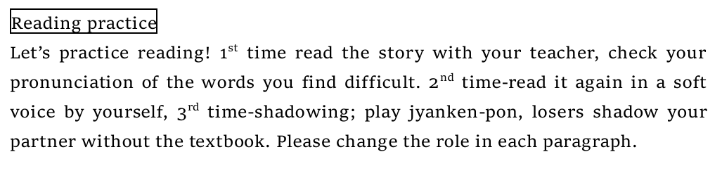


Slide 20
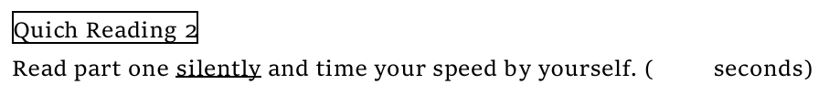
35

Slide 21
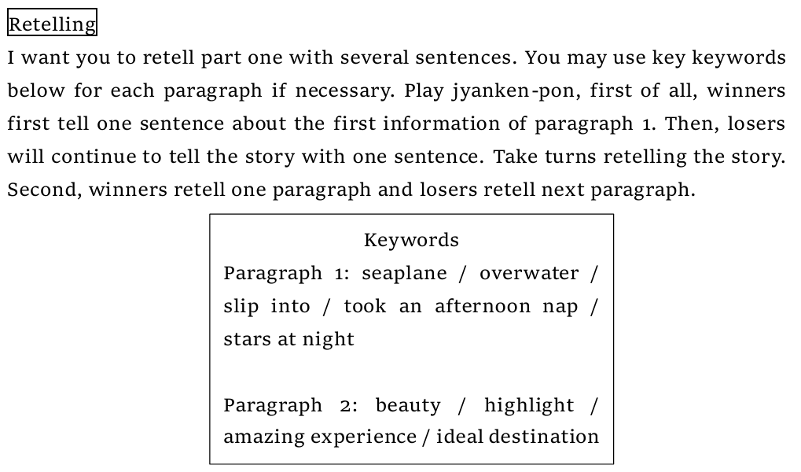

Slide 22


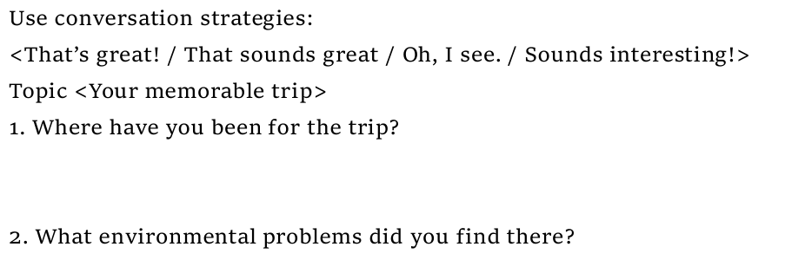
I have been to Taiwan.
I found the climate change problem. It makes the Earth warmer and creates extreme weather.

Slide 23
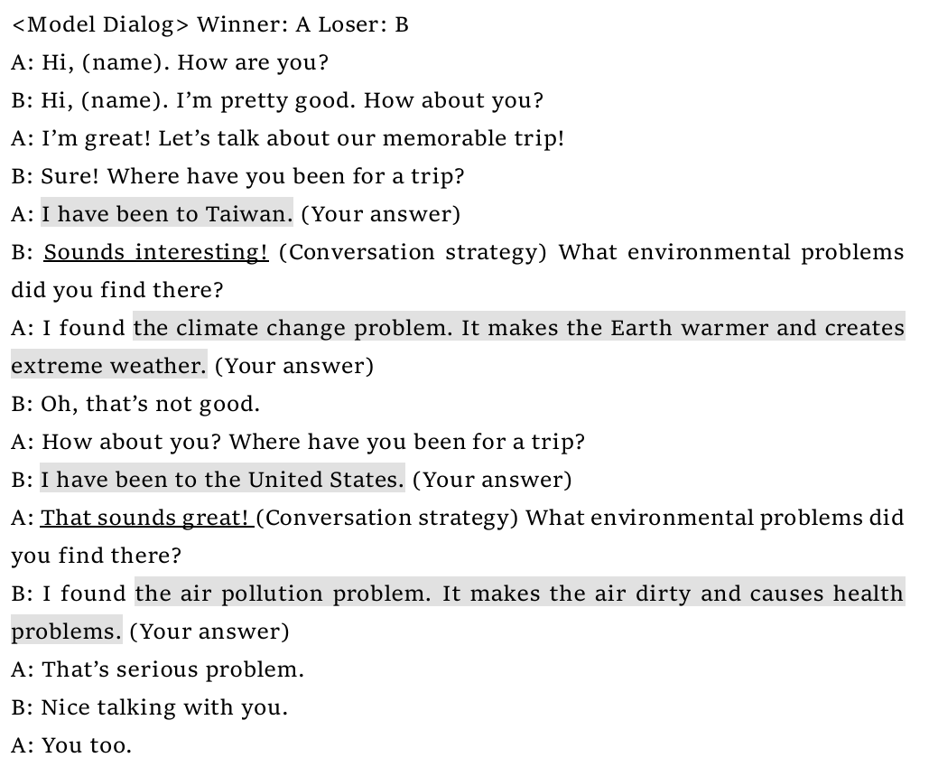
Look at this model dialog and conversation strategies

Slide 24


Slide 25
<Rule>
We have conversations three times. 2nd time, please try not to look at the script. 3rd time, don’t look at the script.
When you talk, please stand up, and when you finish talking, please have a seat
Use conversation strategies.

