Slide 1

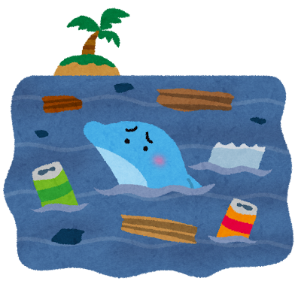
Environmental issues
in tourist spots

Slide 2


Today’s Goal
We can talk about a memory from a trip and
think about the environmental issues there.

Slide 3
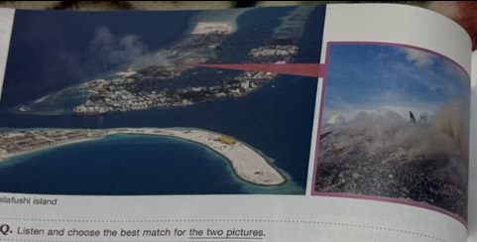
Step1 教科書p82の写真を見て、内容についてクラスメイトと推測しよう。

Slide 4
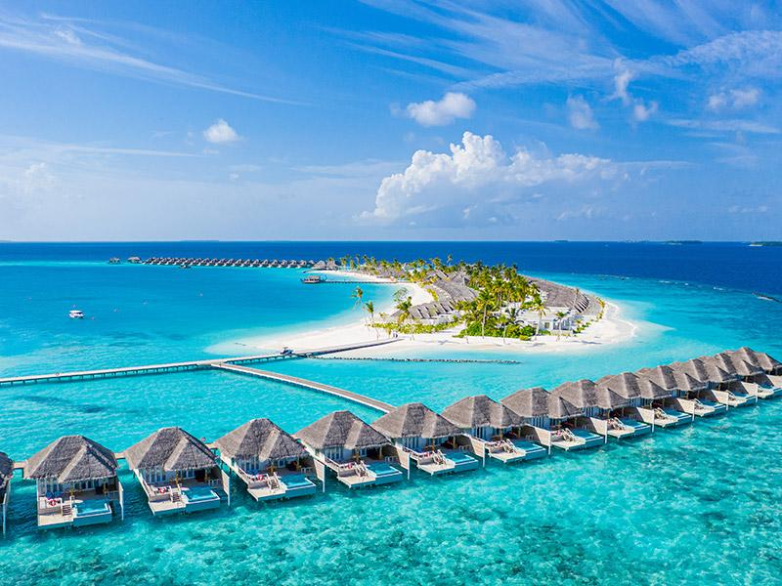
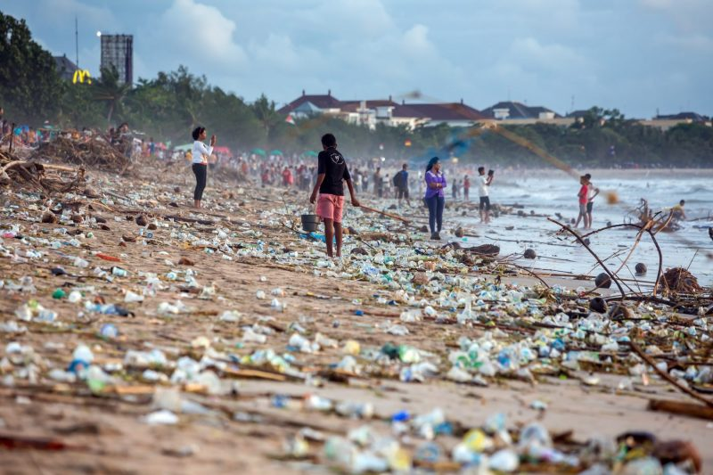
Step2 内容を推測し、以下の文についてT/Fのどちらかに〇を付けよう。
This country is a paradise. T/F
Tourists leave the garbage on this island. T/F
There are more residents than tourists on this island. T/F
It is important for tourists to understand the environmental problems they may cause. T/F

Slide 5
Step3 本文を黙読し、必要があればStep2の答えを変えよう。
This country is a paradise. T/F
Tourists leave the garbage on this island. T/F
There are more residents than tourists on this island. T/F
It is important for tourists to understand the environmental problems they may cause. T/F
×
×

Slide 6



Step4 以下の単語とその意味を線で結ぼう。
Paradise ・ ・観光公害
Overtourism ・ ・積み重ねる
Handle ・ ・ゴミ捨て場
Lagoon ・ ・楽園
Garbage dump・ ・礁湖
Pile ・ ・自然に Pollute ・ ・汚染する
Spontaneously・ ・対処する

Slide 7
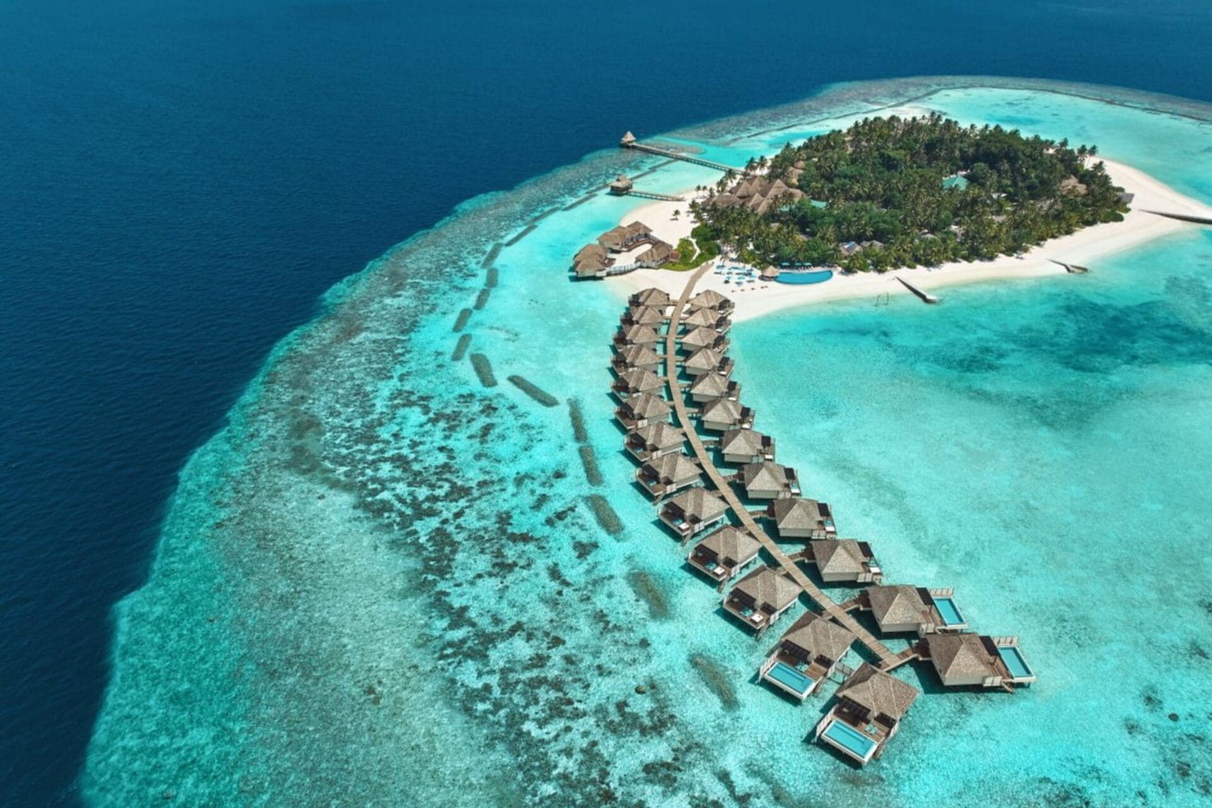
Step5 もう一度本文を黙読し、以下の質問に答えよう。
What is the name of this country?
The Maldives
2. What causes the garbage problem?
Over tourism
3. What did the Thilafalhu lagoon begin to be used as in 1991?
It was used as a garbage dump.
4. What is the name of the area where the garbage was piled up?
Thilafslhu island
5. What should tourists understand?
They shold understand that they may damage our environment.

Slide 8
Step5 もう一度本文を黙読し、以下の質問に答えよう。
What is the name of this country?
The Maldives
2. What causes the garbage problem?
Over tourism
3. What did the Thilafalhu lagoon begin to be used as in 1991?
It was used as a garbage dump.
4. What is the name of the area where the garbage was piled up?
Thilafslhu island
5. What should tourists understand?
They shold understand that they may damage our environment.

Slide 9
Step5 もう一度本文を黙読し、以下の質問に答えよう。
What is the name of this country?
The Maldives
2. What causes the garbage problem?
Over tourism
3. What did the Thilafalhu lagoon begin to be used as in 1991?
It was used as a garbage dump.
4. What is the name of the area where the garbage was piled up?
Thilafslhu island
5. What should tourists understand?
They shold understand that they may damage our environment.

Slide 10
Step5 もう一度本文を黙読し、以下の質問に答えよう。
What is the name of this country?
The Maldives
2. What causes the garbage problem?
Over tourism
3. What did the Thilafalhu lagoon begin to be used as in 1991?
It was used as a garbage dump.
4. What is the name of the area where the garbage was piled up?
Thilafslhu island
5. What should tourists understand?
They shold understand that they may damage our environment.

Slide 11
Step5 もう一度本文を黙読し、以下の質問に答えよう。
What is the name of this country?
The Maldives
2. What causes the garbage problem?
Over tourism
3. What did the Thilafalhu lagoon begin to be used as in 1991?
It was used as a garbage dump.
4. What is the name of the area where the garbage was piled up?
Thilafslhu island
5. What should tourists understand?
They shold understand that they may damage our environment.

Slide 12
Step5 もう一度本文を黙読し、以下の質問に答えよう。
What is the name of this country?
The Maldives
2. What causes the garbage problem?
Over tourism
3. What did the Thilafalhu lagoon begin to be used as in 1991?
It was used as a garbage dump.
4. What is the name of the area where the garbage was piled up?
Thilafslhu island
5. What should tourists understand?
They shold understand that they may damage our environment.

Slide 13

Step6 Let’s practice!
  音読
  Silent reading

Slide 14




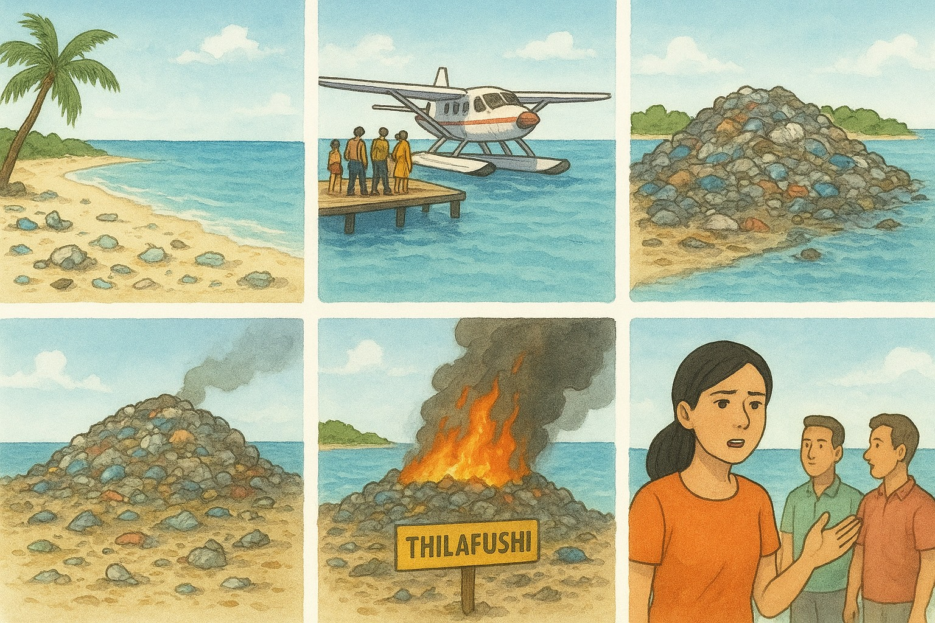











Step７ イラストを見ながらこの話をRetelling してみよう
1
2
3
4
Maldives
Residents
1991
Tourists
lagoon
×Paradise
But…
5
6
7
8
Important
economy
Understand

Slide 15

Step８ Discussion questionについてクラスメイトと意見交換をしよう
Q Have you ever seen an environmental problem that was caused by tourists when you traveled?
Where have you been?
What environmental problems did you find there?
What do you think is the cause of that problem?
What should tourists do to solve this problem?

Slide 16
Step８ Discussion questionについてクラスメイトと意見交換をしよう
Q Have you ever seen an environmental problem that was caused by tourists when you traveled?
Where have you been?
I have been to Tokyo.
2. What environmental problems did you find there?
There was a lot of garbage on the sides of the road.
3. What do you think is the cause of that problem?
I think many tourists throw their garbage away on the road.
4. What should tourists do to solve this problem?
Every tourists should take their garbage home with them.

Slide 17
Step８ Discussion questionについてクラスメイトと意見交換をしよう
Your answer Conversation strategy A: Winner B: Loser
A: Hi, ○○. How are you?
B: Hi, ○○. I’m ○○, and you?
A: I’m ○○. Let’s talk about the environmental problems in the place we traveled before.
B: Yes. When I traveled to Tokyo, I found aｎ environmental problem.
A: Oh, you travelled to Tokyo. Please tell me more. What was the environmental problem in Tokyo?
B: There was a lot of garbage on the sides of the road.
A: That’s sad. So, what is the cause of the problem?
B: I think many tourists throw their garbage away on the road.
A: I see. That’s not good. So, what should tourists do to solve the problem?
A: I think every tourist should take their garbage home with them.
B: That’s a great idea.
★Change your role
A: Nice talking with you.
B: You, too. Bye.

Slide 18

Step 4 Step 2, Step 3で用意した情報を友達に伝えあい、得た情報をリストにまとめよう。
＜Communication Strategies＞
間をつなぐ（えーと。あの～。）Well… Um… Uh… Hmm… Let's see.
相手の言ったことを確かめる（シャドーイング）（例）When do you study? →When?
相手の言ったことにうなずく（ええ。うんうん。そのとおり。）Yes. Uh-huh. That's right.
驚きをつたえる（え、本当に？わぁ、すごいね！）Oh, really? Wow!
興味を示す（私も。おもしろいね。いいね。）Me, too! That's interesting! That's great!

Slide 19
意見交換の内容を表にまとめよう。
Name | Where have you been？ | Environmental problems | The cause of the problem | How to solve the problem
Otoka | Tokyo | A lot of garbage on the sides of the road | Tourists throw their garbage away on the road | Take the garbage home

