Slide 1
Let’s introduce manners!
22011033 Taiyo Fukaya

Slide 2
Goal: 好きな国のマナーについて紹介できるようになろう！！
Announcement

Slide 3
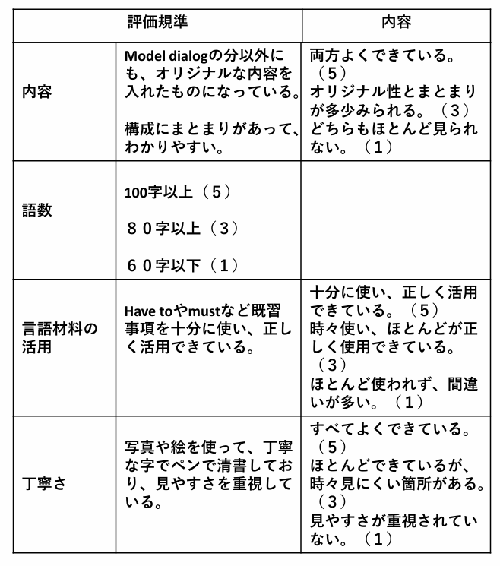
Fun Essay
内容：オリジナルな内容で、構成にまとまりがあるか
語数：１００字以上書けているかどうか
言語材料の活用：既習事項を十分に正しく活用しているか
丁寧さ：写真や絵を使い、
ペンで清書することで見やすさを重視しているか

Slide 4
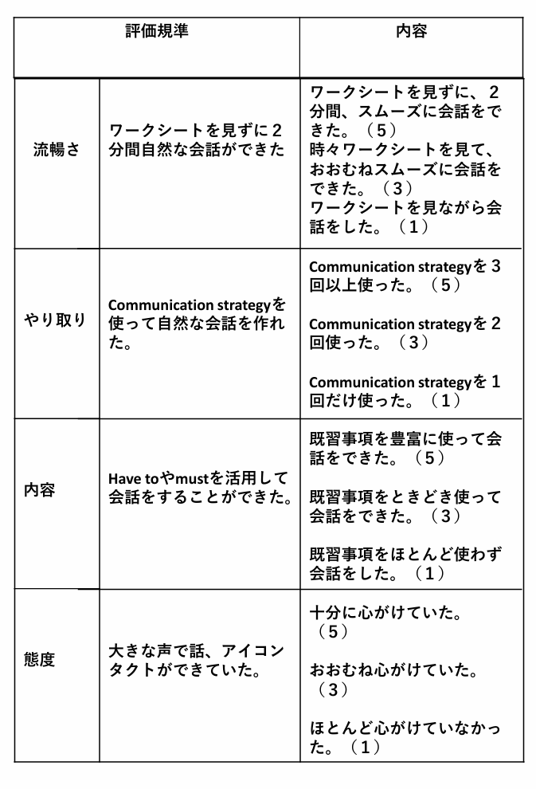
Speaking test
流暢さ：ワークシートを見ずに
２分間自然な会話ができたか
やり取り：Communication strategyを使えたか
内容：既習文法事項を使って会話をすることができたか
態度：大きな声で、アイコンタクトができたか

Slide 5
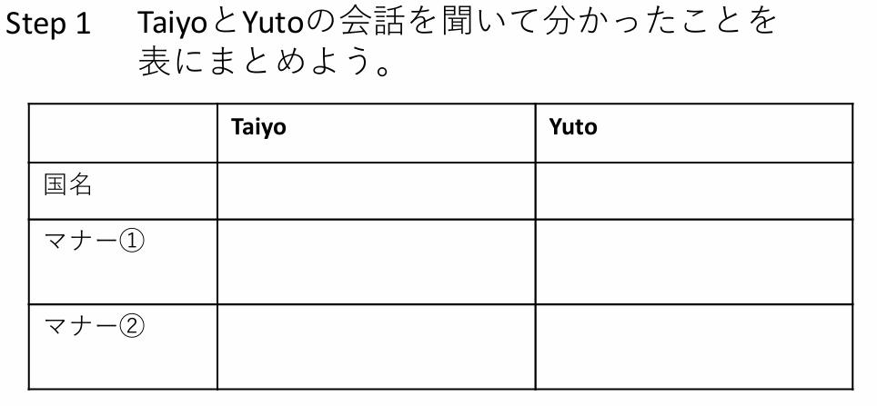


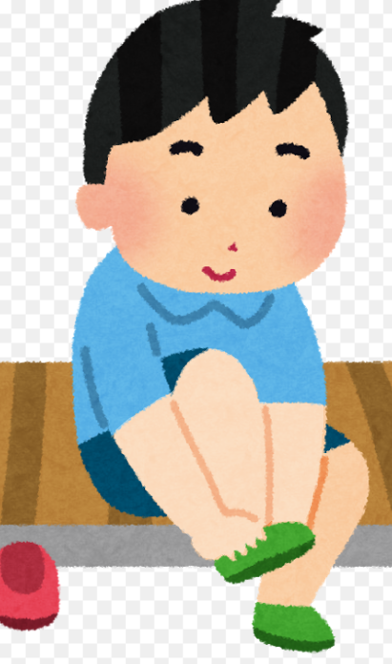

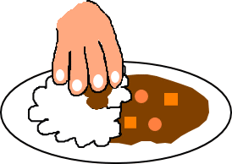

First time→Just listen Second time→take notes!

Slide 6
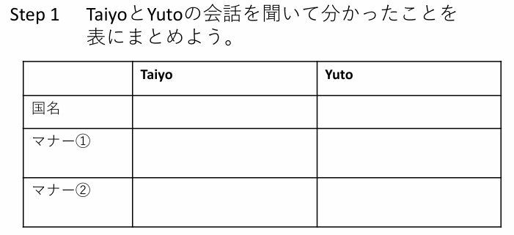
India
Australia
They have to take off their shoes before entering temples or homes
They have to accept other cultures
They have to eat with their right hand, not with their left hand
They have to be on time for meetings or work
First time→Just listen Second time→take notes!

Slide 7
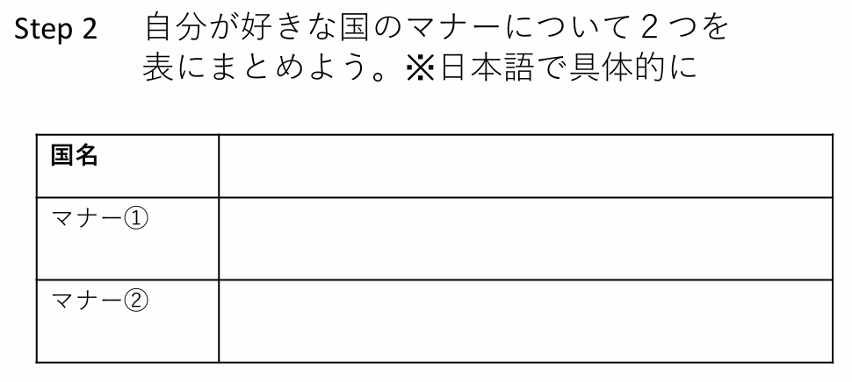
インド
お寺やお家に入る前に靴を脱がなければならない。
左手でご飯を食べるのではなく、右手で食べなければならい。
You can use your phones, iPads and laptops to research the manners of your favorite countries!

Slide 8
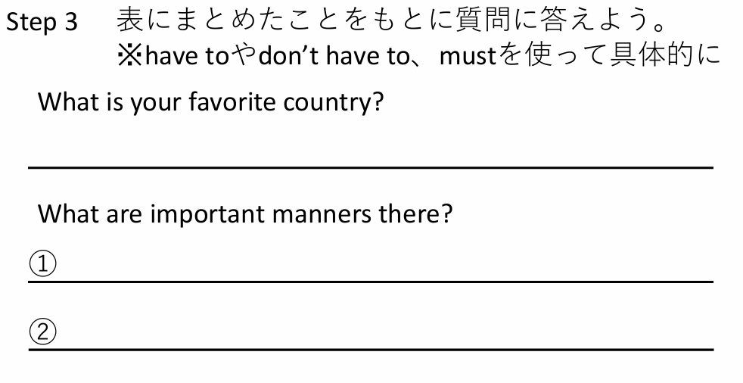
My favorite country is India.
In India, they have to take off their shoes before entering temples or homes.
they have to eat with their right hand, not with their left hand.
Do not translate Japanese into English on your phones!

Slide 9
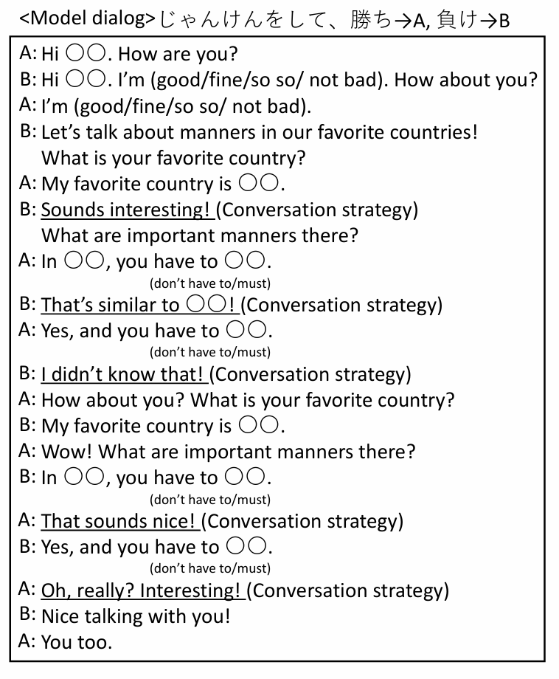
Step 3でまとめた情報を使って、会話をしてみよう！

Slide 10
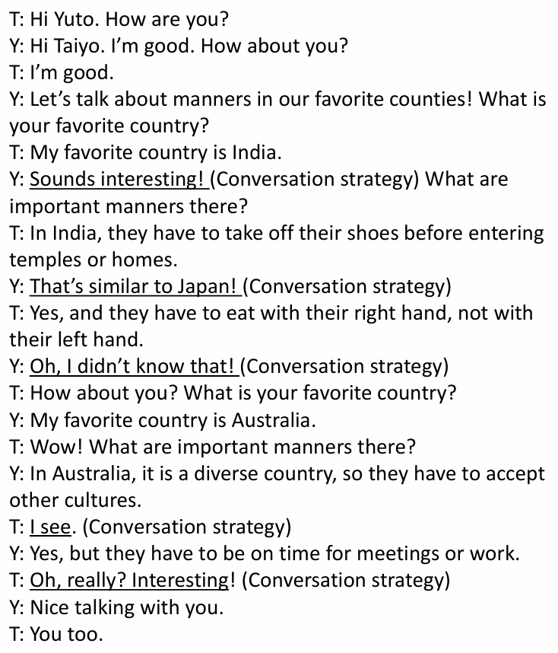
Model Dialog

Slide 11
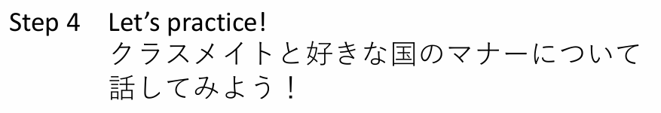
1st time: You can look at model dialog
2nd time: Please try not look at the model dialog
3rd time: Do not look at model dialog
会話を終えたら、メモにまとめよう！

Slide 12
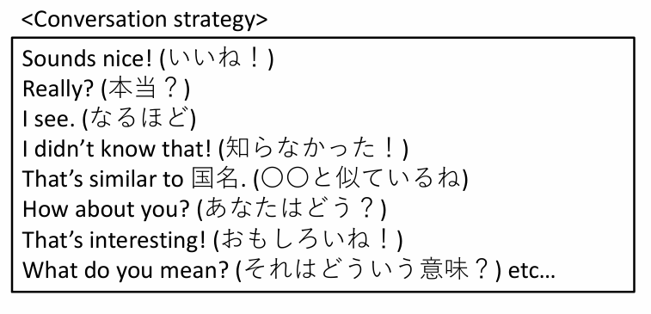
Please use conversation strategies!

Slide 13
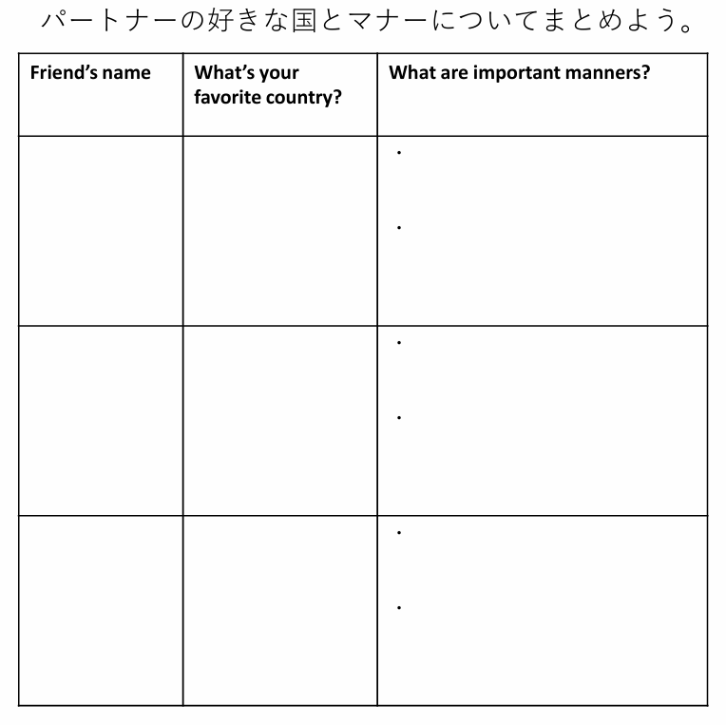
They have to accept other cultures
Yuto
Australia
They have to be on time for meetings or work

Slide 14
Reminder
Please prepare for the speaking test and the fun essay

