Slide 1




Let’s find our favorite food!!
22011033 Taiyo Fukaya

Slide 2
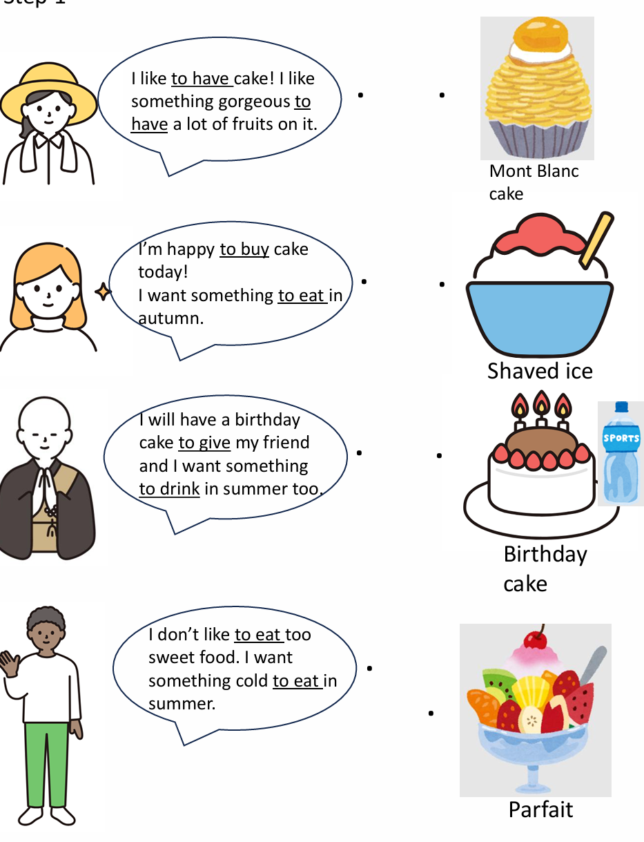

Step 1
?
?
?
1st Listen
?
2nd

Slide 3
Let’s review the vocabulary!
Mont Blanc Cake

Slide 4
Shaved Ice

Slide 5
Birthday cake

Slide 6
Parfait

Slide 7
Step 1
?
?
?
1st Listen
?
2nd

Slide 8
Check the answers in Pairs

Slide 9
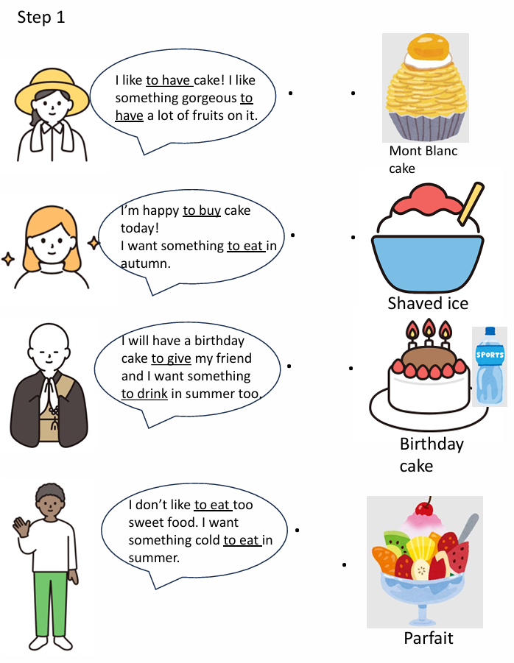
The first person likes ~~~~~
The second person likes ~~~~~
…

Slide 10
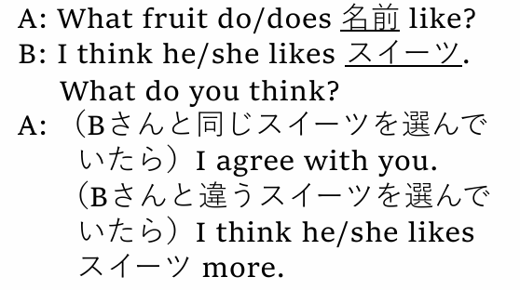
Step 2
Listen to the model dialog and let’s share their favorite sweets!

Slide 11
Step 3: Grammar points
①like to cook | （ ）が好き
②want to study | （ ）したい
③something to eat | （ ）もの
④something to drink | （ ）もの
⑤I’m glad to see you. | （ ）うれしい。
⑥I went to a store to buy a cake. | （ ）店へ行った。
料理すること
勉強（することを）
食べるための/べき
飲むための/べき
私はあなたに会えて
ケーキを買うために

Slide 12
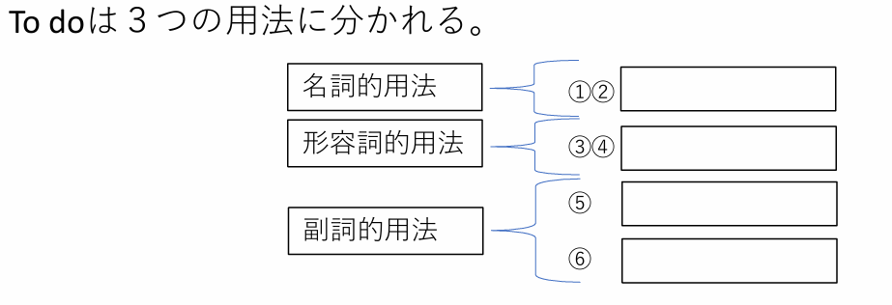
Step 3: Grammar points
～すること
～するための、べき
～して
～するために

Slide 13
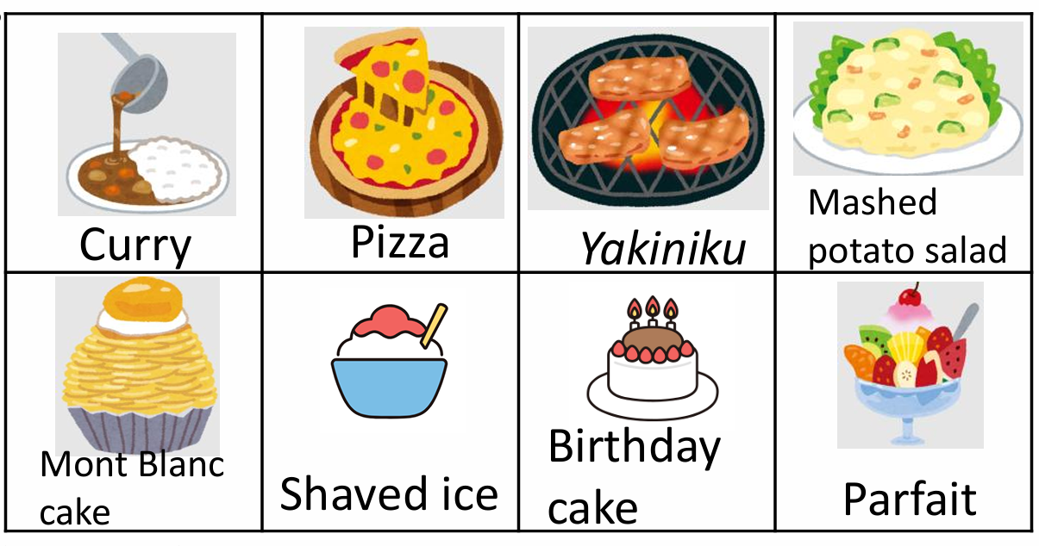
Step 4
Let’s talk about our favorite dish!
Options
Birthday cake

Slide 14
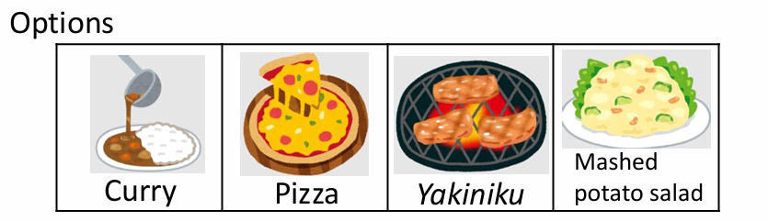
Step 4
Let’s talk about our favorite dish!
Birthday cake
Example
Let’s listen to the model conversation with the example above

Slide 15

Step 4 Model Dialog

Slide 16

Step 4
Let’s talk about our favorite dish!
Ex:)
I like to make it.
I love something gorgeous to eat with some fruits.
I cut it to give a piece of it to my friends.

Slide 17
Step 4
Let’s talk about our favorite dish!
<Rule>
Please do じゃんけん、Winner⇒A, Loser⇒B
Use three sentences with to 不定詞 for hints.
When you don’t know what to say, please use vocabulary from the conversation strategies.
1st time, You can look at your script. In the second time, please try not to look at it and third time, do not look at it and enjoy talking.
Conversation Strategies
間をつなぐ(えーと。あの～。)Well… Um… Uh… Hmm.. Let’s see.
相手の正解したとき(正解！)You are correct!
相手が不正解のとき(不正解！)You are not correct.
ヒントがさらにほしい時 Please give me more hints!
興味を示す(私も。面白いね。いいね。)Me too! That’s interesting! That’s great!

Slide 18
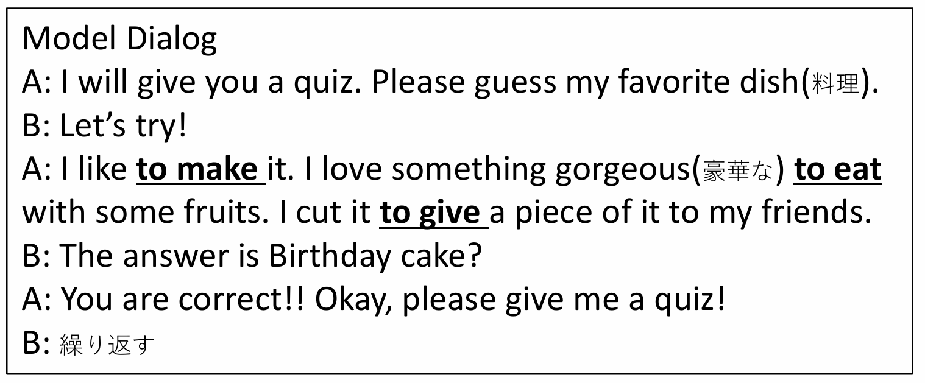
Step 4

Slide 19
Thank you

