Slide 1
Japanese celebrities and things
22011033 Taiyo Fukaya

Slide 2

Today’s Goal
We are going to be able to explain about Japanese celebrities and things
日本の有名人やモノについて説明できるようになろう！！

Slide 3
Step 1
Do not take notes
Look at the presentation slides

Slide 4
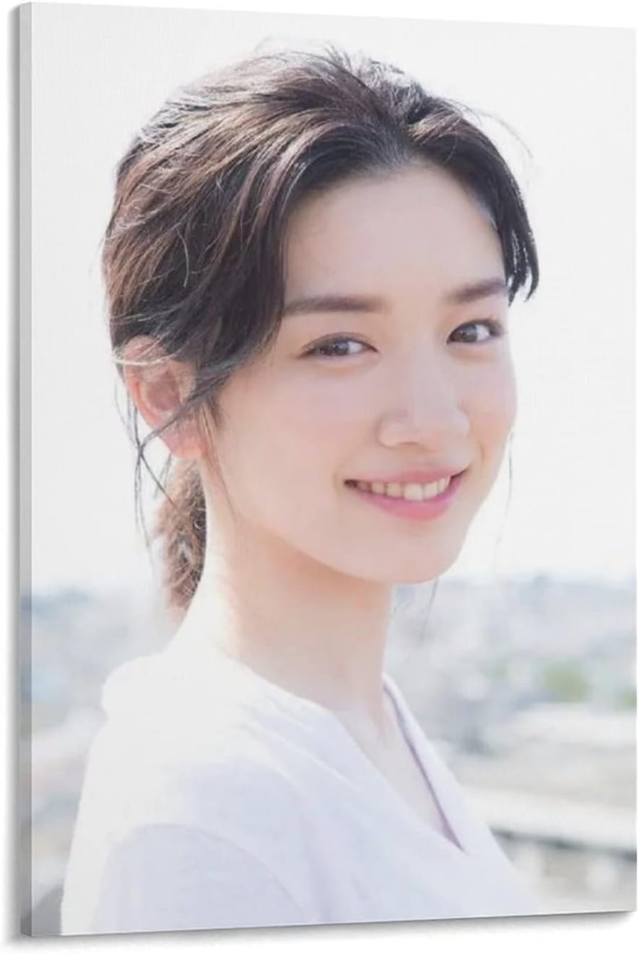
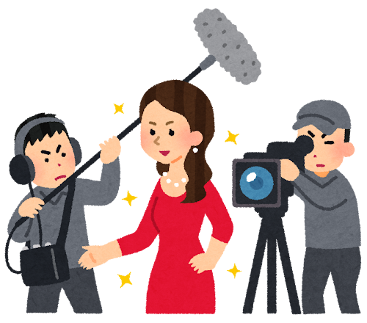
Step 1 ①

Slide 5
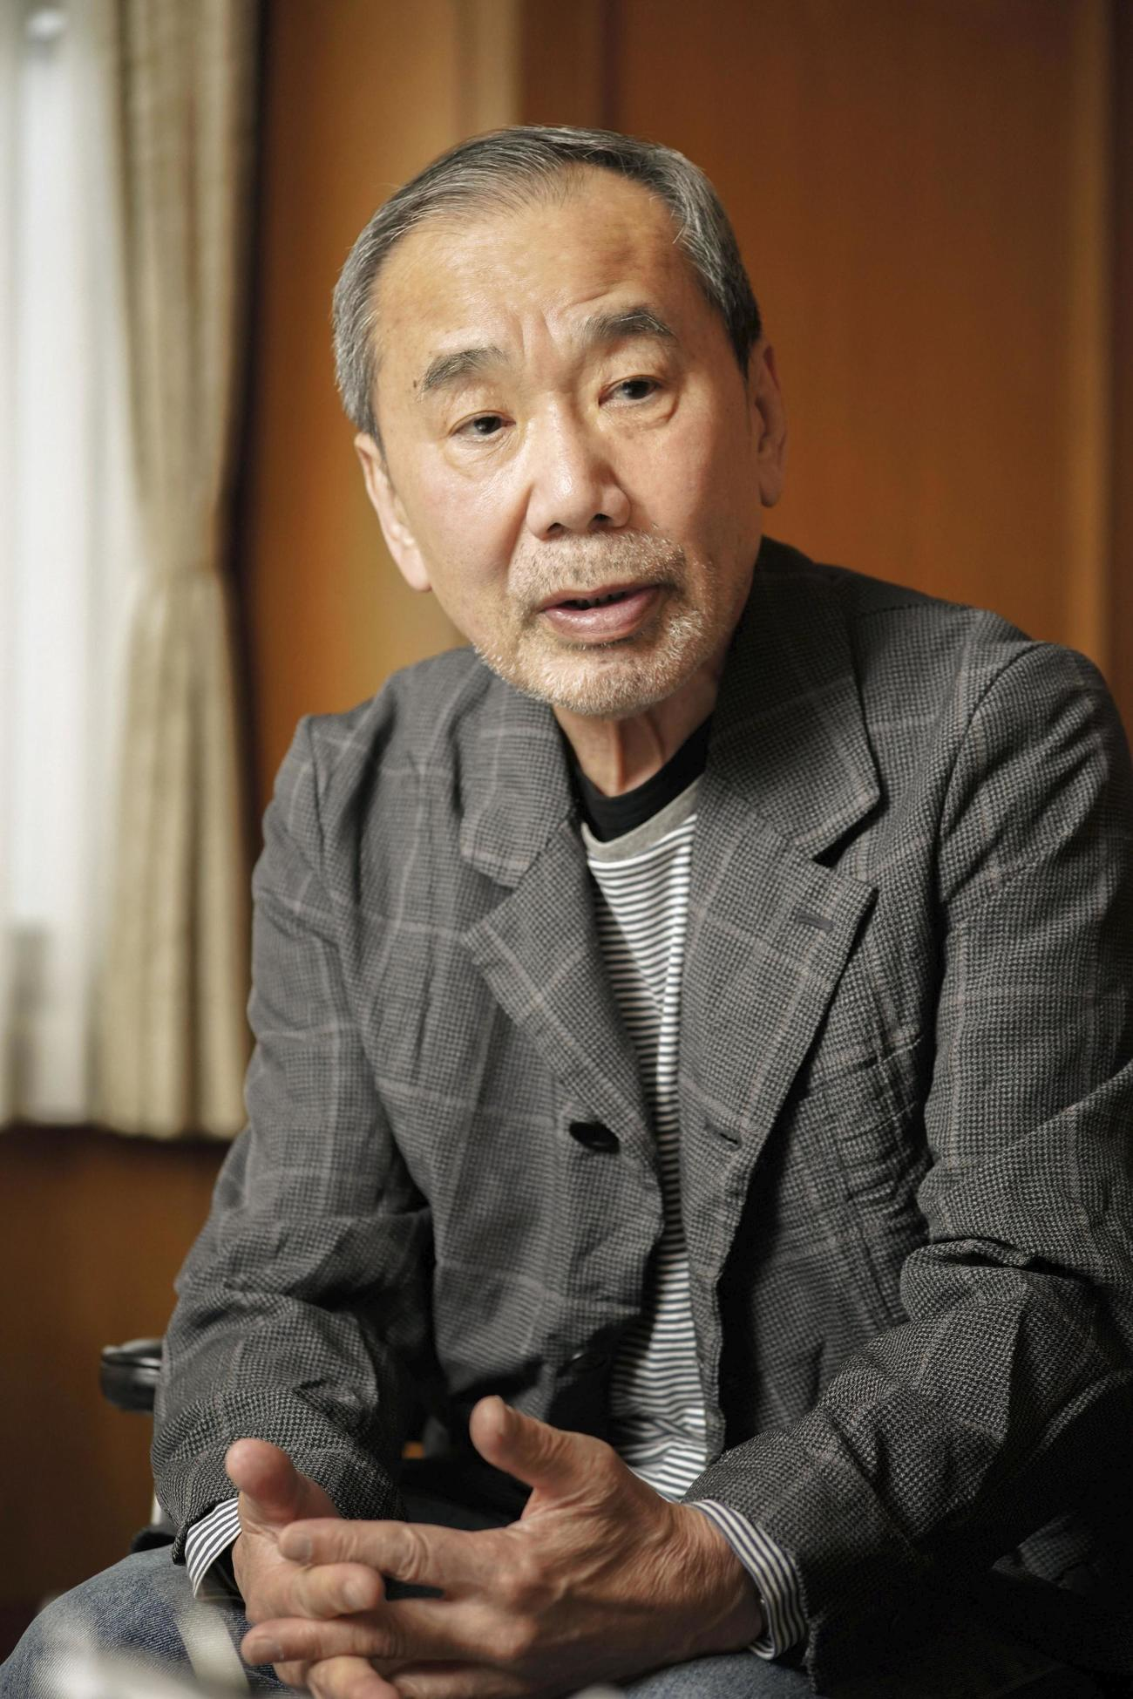

Step 1 ②

Slide 6
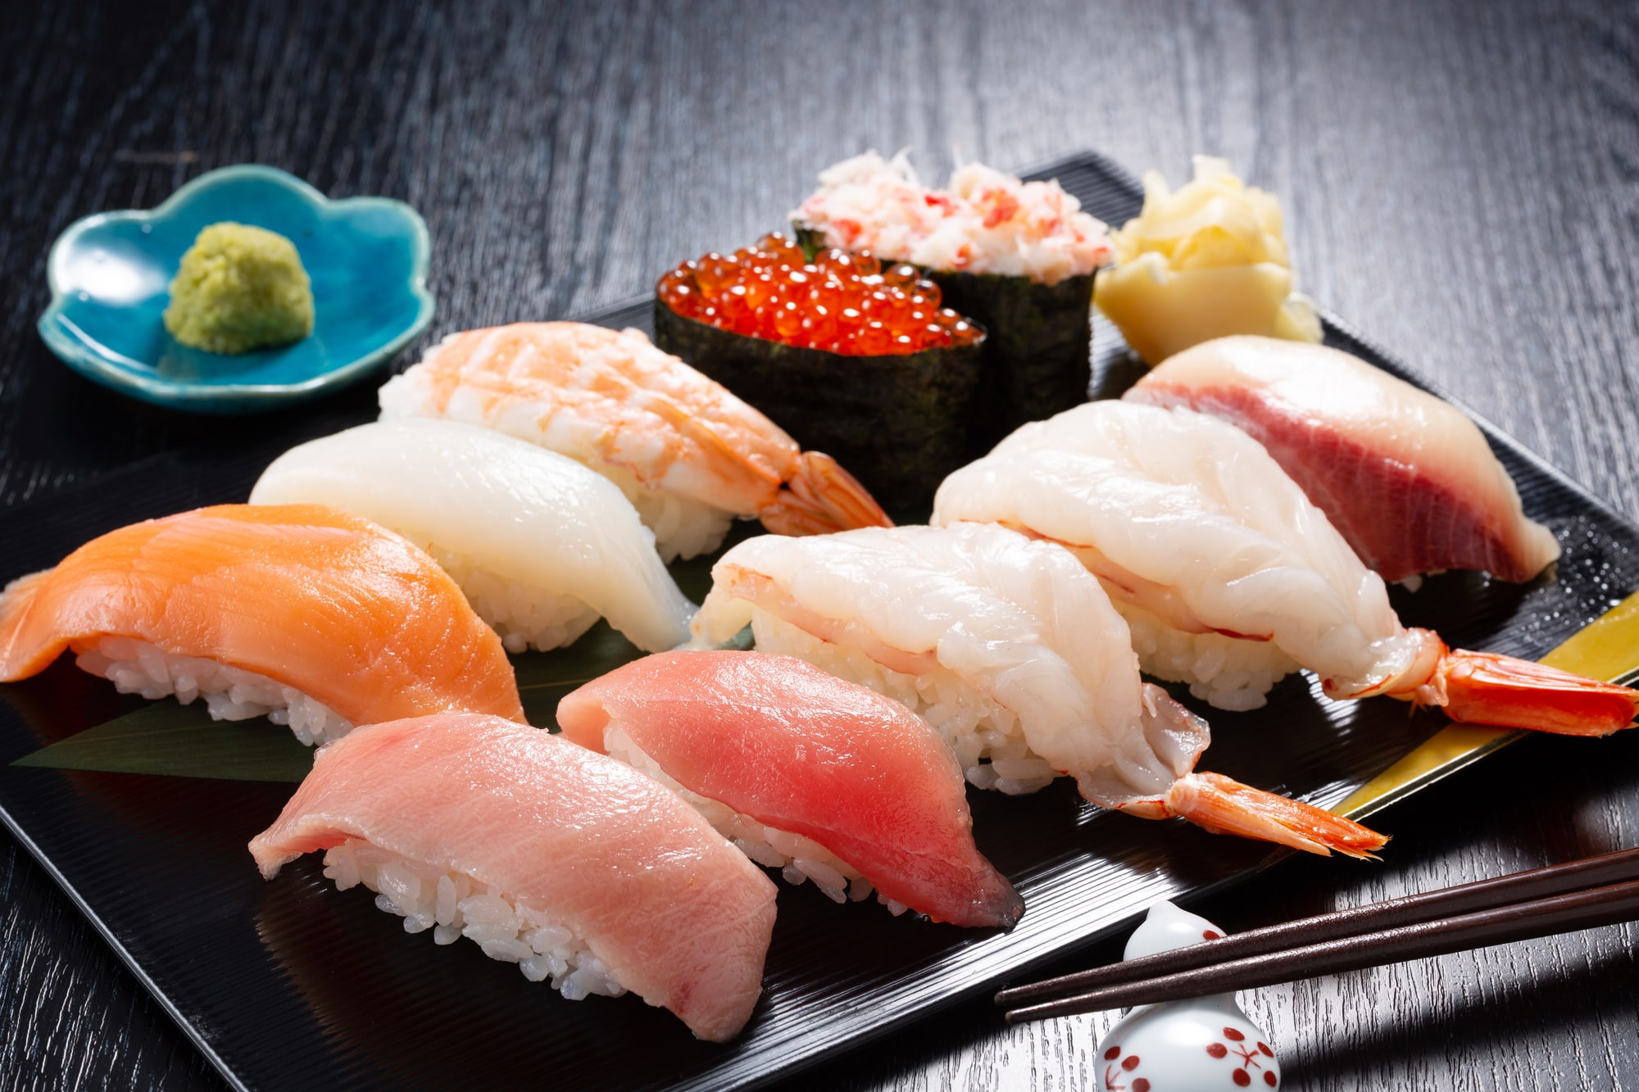

Step 1 ③

Slide 7
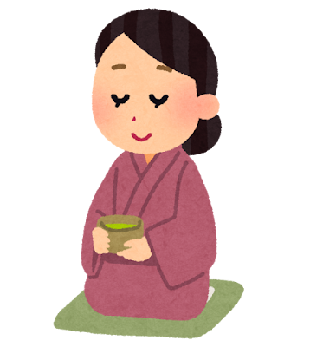
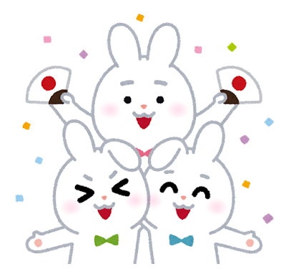
Step 1 ④

Slide 8
Step 1
Fill in the blanks
in English

Slide 9
Step 1
Check your answers
in pairs

Slide 10
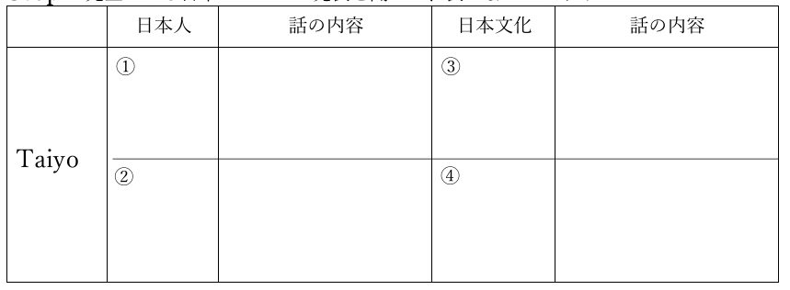
Step 1
It shows Japanese culture
Mei
Nagano
Natural acting style
Sushi
He wrote many popular novels
It shows respect and hospitality
Haruki Murakami
Tea ceremony

Slide 11
Step 2
Let’s circle the correct answers

Slide 12
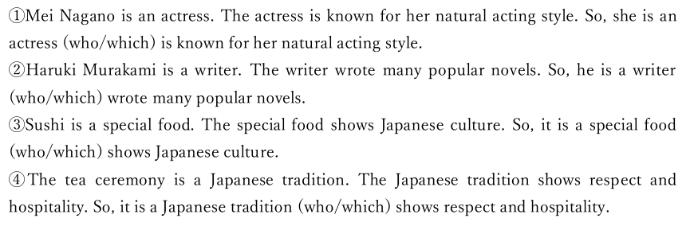
Step 2

Slide 13
Step 3
Let’s fill in the blanks

Slide 14
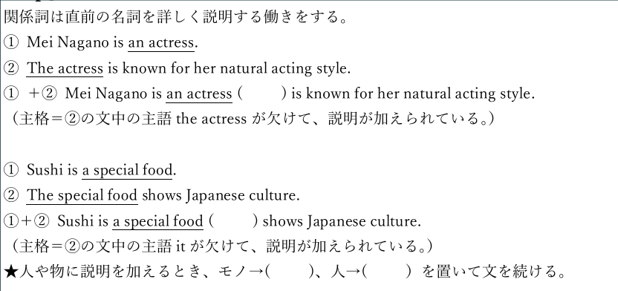
Step 3
Who
which
which
Who

Slide 15
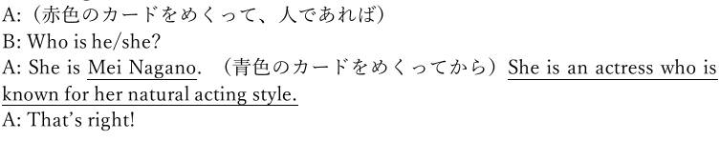
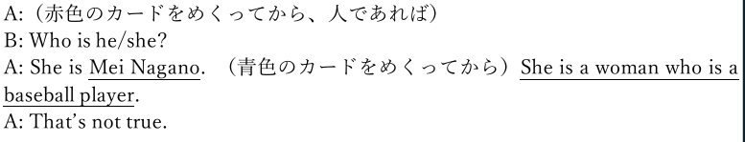
Step 4
<Model Dialog>
Winner→A, Loser→B
1 point
(Lucky number→2 points)
0 point

Slide 16
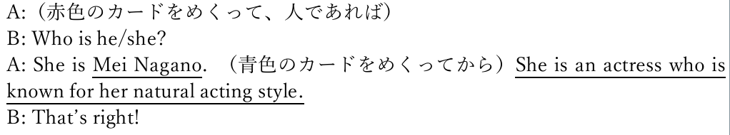
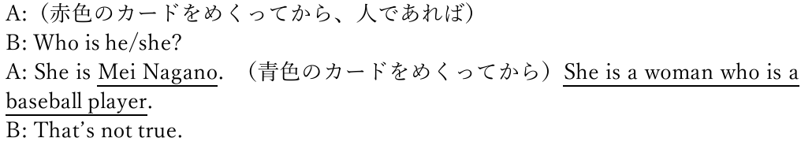
Step 4
<Model Dialog>
Winner→A, Loser→B
1 point
(Lucky number→2 points)
0 point

Slide 17

Step 4
①She is Mei Nagano

Slide 18
Step 4
① The actress is known for natural acting style

Slide 19
Step 4
①She is Mei Nagano
① The actress is known for natural acting style

Slide 20
Step 4
<Model Dialog>
Winner→A, Loser→B
1 point
(Lucky number→2 points)
0 point

Slide 21
Step 4
①She is Mei Nagano

Slide 22
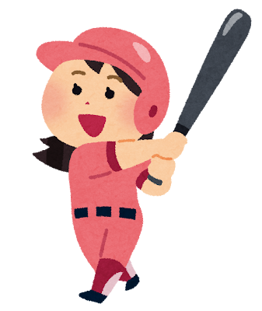
Step 4
⑤ The woman is a baseball player

Slide 23
Step 4
<Model Dialog>
Winner→A, Loser→B
1 point
(Lucky number→2 points)
0 point

Slide 24
Step 4
What is your total score?

Slide 25
Step 5
Let’s write three sentences from cards!

